Slide 1


Interactive Polling for Your Feedback
Using PollEverywhere
We are using a polling tool that integrates with PowerPoint.
Please join for the duration of the meeting using one of the following:
  Using the QR Code shown on your phone
  Visiting PollEv.com/newgen920 from a browser
  Texting NEWGEN920 to 22333 once to join

Slide 2
Street Funding Discussion
Funding Future and Maintaining Existing Streets
Kyle Schniederjan – Director of CP&D Engineering
Donny Hooper – Director of Public Works
Chris Mitchell – Street Superintendent
Michael Padilla – Traffic Superintendent
Matthew Garrett – NewGen Strategies and Solutions
April 19–20, 2023

Slide 3
Agenda
Goals and Objectives
Introduction to Public Works, Street Department and Traffic Department
Street Department Staff’s Evaluation of Level of Service
Traffic Department Staff’s Evaluation of Level of Service
Consultant Lead Committee Input

Slide 4
Goals and Objectives
Why are we here?
Explore funding strategies to construct future streets and maintain existing streets
Consider funding options
  Typical municipal General Fund
  Enterprise Fund
  Tax based vs. fee based
  Funding for RR&R, Maintenance, Operations, and Growth
Consider levels of service
  Arterial streets
  Residential streets
  Alleys
  Street signs and public messaging
  Traffic Signals
  Bridges
  State and federal participation requirements
Other policy considerations
  Development policy questions
  Exemptions
  Rate
Policy recommendations

Slide 5

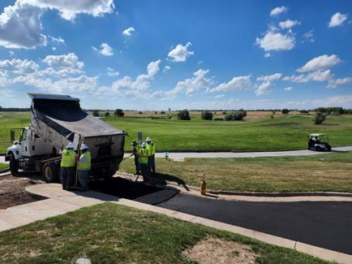
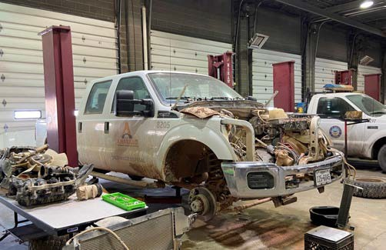
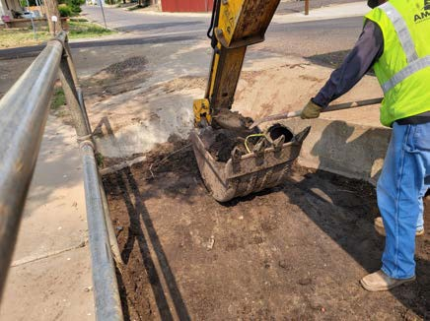
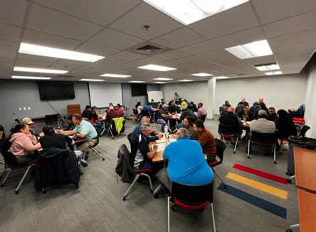
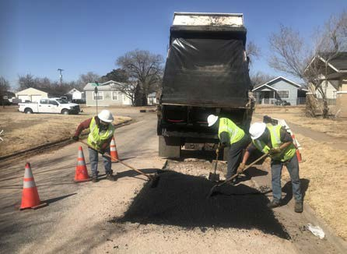
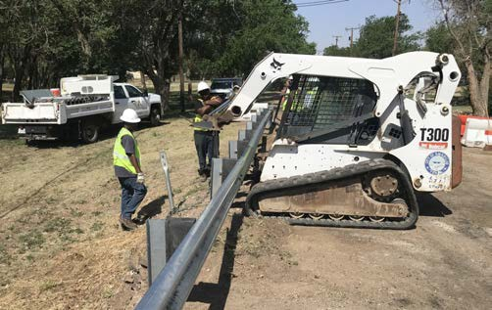
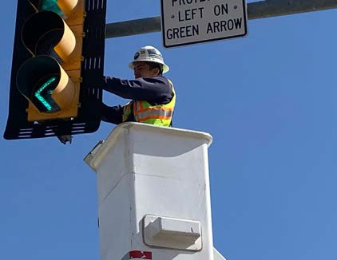
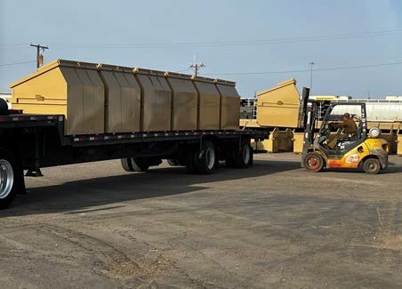
Power BI Desktop
City of Amarillo – Public Works Department
Overview
PDP

Slide 6
Public Works Department
Power BI Desktop
5 Divisions – 401 FT Positions
  Public Works Department Admin - 5
    Fleet Services - 45
    Drainage Utility - 32
    Solid Waste – 117/41
    Streets - 94
    Traffic - 67

Slide 7

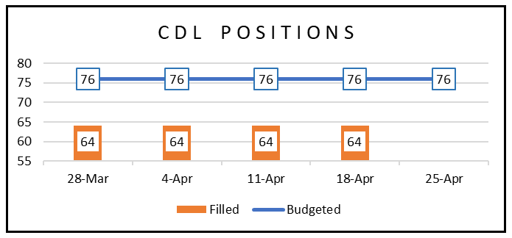

Slide 8
Interactive Polling for Your Feedback
Using PollEverywhere
We are using a polling tool that integrates with PowerPoint.
Please join for the duration of the meeting using one of the following:
  Using the QR Code shown on your phone
  Visiting PollEv.com/newgen920 from a browser
  Texting NEWGEN920 to 22333 once to join

Slide 9

Poll
What kind of chocolate do you prefer?
To participate:
PollEv.com/newgen920
or
Text NEWGEN920 to 22333 once to join
Notes:
Poll Title: Do not modify the notes in this section to avoid tampering with the Poll Everywhere activity.
More info at polleverywhere.com/support
What kind of chocolate do you prefer?
https://www.polleverywhere.com/multiple_choice_polls/Fh6MDFacRu5daLN6VenXm?state=opened&flow=Default&onscreen=persist

Slide 10
Typical Responses Requested
Relating to Service Levels, Not Specific Costs

Slide 11
Street Department
Budget Categories, FY 2022/23
Includes a share of costs from the Public Works and CP&DE Departments

Slide 12
Street Department
Pavement Maintenance & Repair
Employees
A total of 34 positions are funded for this subdivision
​Key Activities
Pothole Patching
9 to 25 square feet in size
Two patch truck crews – goal to have a crew in all four quadrants of the City
Each patching takes 20–30 minutes
7,400 potholes patched in 2019
7,765 annual manhours
Streets take precedent to alleys
Pothole Patching Response Times

Slide 13
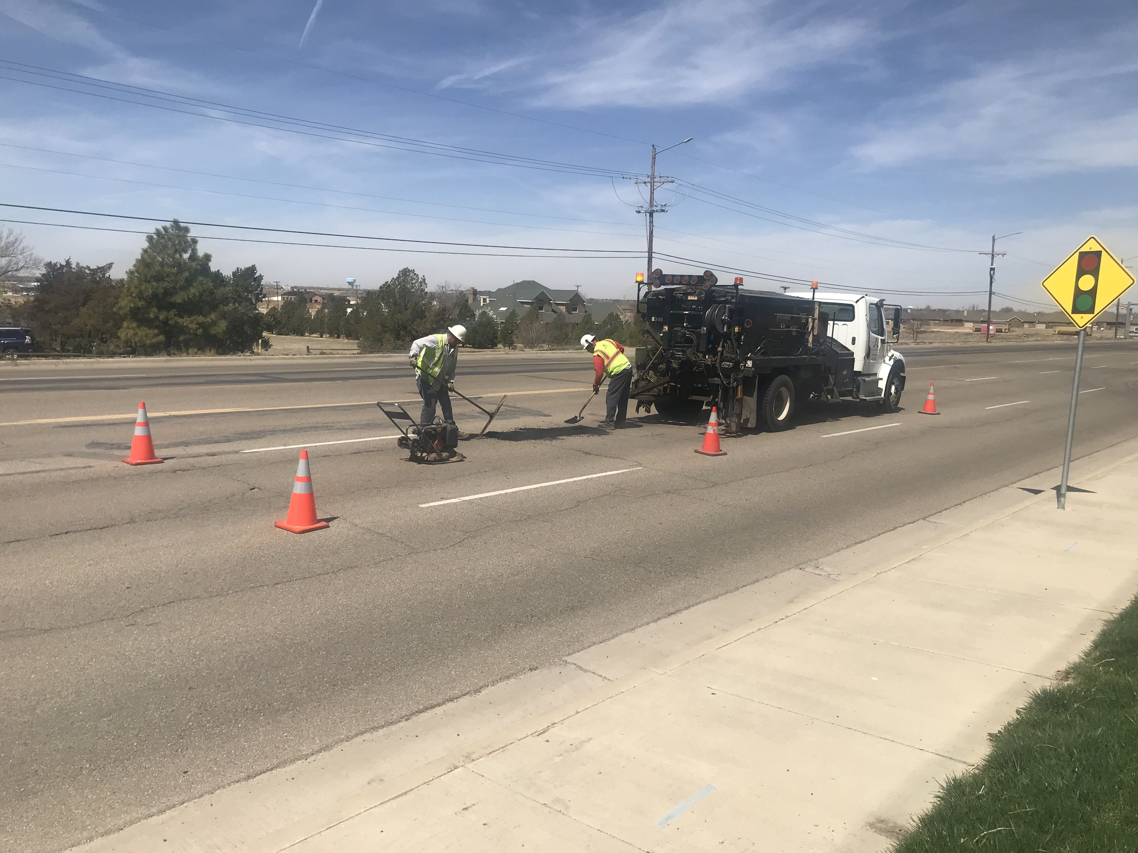

Slide 14
For Pothole Patching Response Times, what service level do you think the City should be targeting?
Please type in a numerical value.
Pothole Patching Response Times
To participate:
PollEv.com/newgen920
or
Text NEWGEN920 to 22333 once to join
Notes:
Poll Title: Do not modify the notes in this section to avoid tampering with the Poll Everywhere activity.
More info at polleverywhere.com/support
For Pothole Patching Response Times, what service level do you think the City should be targeting?
https://www.polleverywhere.com/free_text_polls/aS7TT6qsC1gPDpclcs1kk

Slide 15
Street Department
Pavement Maintenance & Repair
Minor Asphalt Repair
25 to 200 square feet in size
Sub-grade (underneath pavement) repair may be required
Two minor asphalt repair crews – goal to have a third crew
Each repair takes 3–8 hours
19,999 annual manhours
Streets take precedent to alleys
Major Repair
Greater than 200 square feet in size
Sub-grade repairs
Two tear-out stabilization crews and laydown machine
Covers both streets and alleys
16,829 annual manhours
Minor Asphalt Repair Response Times
Major Repair Response Times

Slide 16
For Minor Asphalt Repair Response Times, what service level do you think the City should be targeting?
Please type in a numerical value.
Minor Asphalt Repair Response Times
To participate:
PollEv.com/newgen920
or
Text NEWGEN920 to 22333 once to join
Notes:
Poll Title: Do not modify the notes in this section to avoid tampering with the Poll Everywhere activity.
More info at polleverywhere.com/support
For Minor Asphalt Repair Response Times, what service level do you think the City should be targeting?
https://www.polleverywhere.com/free_text_polls/uvsymrEckIvQbLjKdxMZ2

Slide 17
For Major Repair Response Times, what service level do you think the City should be targeting?
Please type in a numerical value.
Major Repair Response Times
To participate:
PollEv.com/newgen920
or
Text NEWGEN920 to 22333 once to join
Notes:
Poll Title: Do not modify the notes in this section to avoid tampering with the Poll Everywhere activity.
More info at polleverywhere.com/support
For Major Street Repair Response Times, what service level do you think the City should be targeting?
https://www.polleverywhere.com/free_text_polls/XjP28d2kCg1HKQth5b4Tt

Slide 18
Street Department
Budget Categories, FY 2022/23
Includes a share of costs from the Public Works and CP&DE Departments

Slide 19
Street Department
Pavement Preservation
Employees
A total of 17 positions are funded for this subdivision
​Key Activities
Crack Seal – In House​
Sealing cracks in existing pavement​
2019 cost = $2,166 per lane mile​
During winter months​
4,399 annual manhours​
Crack Seal Frequency of Service

Slide 20
For Crack Seal Frequency of Service, what service level do you think the City should be targeting?
Please type in a numerical value.
Crack Seal Frequency of Service
To participate:
PollEv.com/newgen920
or
Text NEWGEN920 to 22333 once to join
Notes:
Poll Title: Do not modify the notes in this section to avoid tampering with the Poll Everywhere activity.
More info at polleverywhere.com/support
For Creak Seal Frequency of Service, what service level do you think the City should be targeting?
https://www.polleverywhere.com/free_text_polls/iRdoTuOv8jRjfeHouDi0m

Slide 21
Street Department
Pavement Preservation
Sealcoat (Chipseal) – In House​
Applies a thin, liquid asphalt layer and gravel to existing pavement surface
2019 cost = $13,506 per lane mile
During summer months, on a 10-yr cycle citywide
8,237 annual manhours
Alley Seal – In House
Applies a thin, liquid emulsion layer to existing pavement surface
2019 cost = $18,982 per mile
Generally performed in Spring and Fall
1,950 annual manhours
Sealcoat Frequency of Service
Alley Seal Frequency of Service

Slide 22
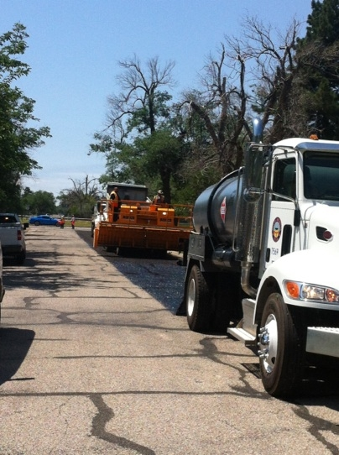

Slide 23
For Sealcoat Frequency of Service, what service level do you think the City should be targeting?
Please type in a numerical value.
Sealcoat Frequency of Service
To participate:
PollEv.com/newgen920
or
Text NEWGEN920 to 22333 once to join
Notes:
Poll Title: Do not modify the notes in this section to avoid tampering with the Poll Everywhere activity.
More info at polleverywhere.com/support
For Sealcoat Frequency of Service, what service level do you think the City should be targeting?
https://www.polleverywhere.com/free_text_polls/TQWSjSD3F0FCemP3fYvhW

Slide 24
For Alley Seal Frequency of Service, what service level do you think the City should be targeting?
Please type in a numerical value.
Alley Seal Frequency of Service
To participate:
PollEv.com/newgen920
or
Text NEWGEN920 to 22333 once to join
Notes:
Poll Title: Do not modify the notes in this section to avoid tampering with the Poll Everywhere activity.
More info at polleverywhere.com/support
For Alley Seal Frequency of Service, what service level do you think the City should be targeting?
https://www.polleverywhere.com/free_text_polls/dZUVH1wcvSv7HHK6F9Os5

Slide 25
Street Department
Pavement Preservation
Resurfacing (Capital Project)​
Overlay – 1” of new asphalt onto existing pavement (some removal of existing pavement may be required)
Arterial Chipseal – small rock chips and hot oil
Cape Seal – combination of Chipseal and Micro Surface
During summer months
External manhours
Resurfacing Frequency of Service

Slide 26
For Resurfacing Frequency of Service, what service level do you think the City should be targeting?
Please type in a numerical value.
Resurfacing Frequency of Service
To participate:
PollEv.com/newgen920
or
Text NEWGEN920 to 22333 once to join
Notes:
Poll Title: Do not modify the notes in this section to avoid tampering with the Poll Everywhere activity.
More info at polleverywhere.com/support
For Resurfacing Frequency of Service, what service level do you think the City should be targeting?
https://www.polleverywhere.com/free_text_polls/fxEzV6JhyvZi7psisYYPw

Slide 27
Street Department
Budget Categories, FY 2022/23
Includes a share of costs from the Public Works and CP&DE Departments

Slide 28
Street Department
Unpaved Streets & Alleys
Employees
13 positions are funded for this subdivision
​Key Activities
Unpaved Streets
Maintenance and repair of 83 miles of unpaved streets
25 miles maintained annually (30%)
Workload is not actively increasing
Unpaved Alleys
Maintenance and repair of 279 miles of unpaved alleys
37 miles maintained annually (13%)
Workload is not actively increasing
Unpaved Streets Miles Maintained
Unpaved Alleys Miles Maintained

Slide 29
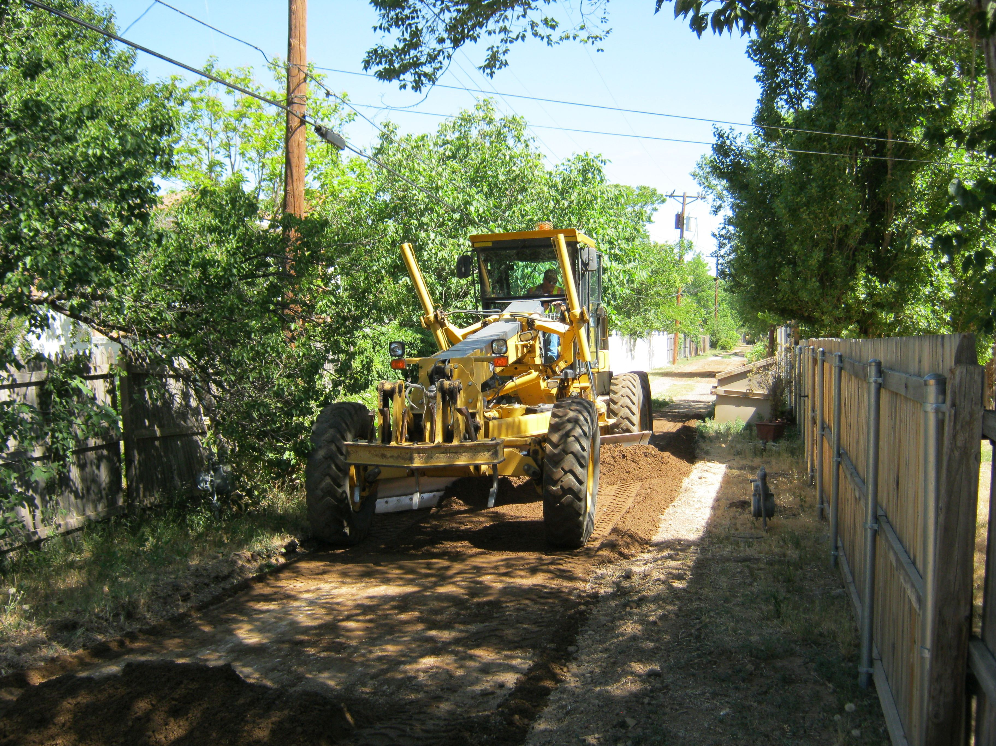

Slide 30
For Unpaved Streets Miles Maintained, what service level do you think the City should be targeting?
Please type in a numerical value.
Unpaved Streets Miles Maintained
To participate:
PollEv.com/newgen920
or
Text NEWGEN920 to 22333 once to join
Notes:
Poll Title: Do not modify the notes in this section to avoid tampering with the Poll Everywhere activity.
More info at polleverywhere.com/support
For Unpaved Streets Miles Maintained, what service level do you think the City should be targeting?
https://www.polleverywhere.com/free_text_polls/bvqY7Yu2QPGVRI8eMcLEM

Slide 31
For Unpaved Alleys Miles Maintained, what service level do you think the City should be targeting?
Please type in a numerical value.
Unpaved Alleys Miles Maintained
To participate:
PollEv.com/newgen920
or
Text NEWGEN920 to 22333 once to join
Notes:
Poll Title: Do not modify the notes in this section to avoid tampering with the Poll Everywhere activity.
More info at polleverywhere.com/support
For Unpaved Alleys Miles Maintained, what service level do you think the City should be targeting?
https://www.polleverywhere.com/free_text_polls/UBstz8iF42VA2B2bRTJmM

Slide 32
Street Department
Budget Categories, FY 2022/23
Includes a share of costs from the Public Works and CP&DE Departments

Slide 33
Street Department
Miscellaneous | Winter Operations
Employees
0 positions are funded for this subdivision
​Key Activities
Performs snow / ice control on arterial and collector street, overpasses, etc.
Workload varies from year to year
1,600 tons of de-icing material applied 2019
1,200 snow removal lane miles
8 dump trucks converted to plow / sand trucks
Goal to have 10 trucks
Objective performance indicators are not available. Staff’s subjective assessment is that performance is around 60% of potential.
Winter Operations Subjective Assessment

Slide 34
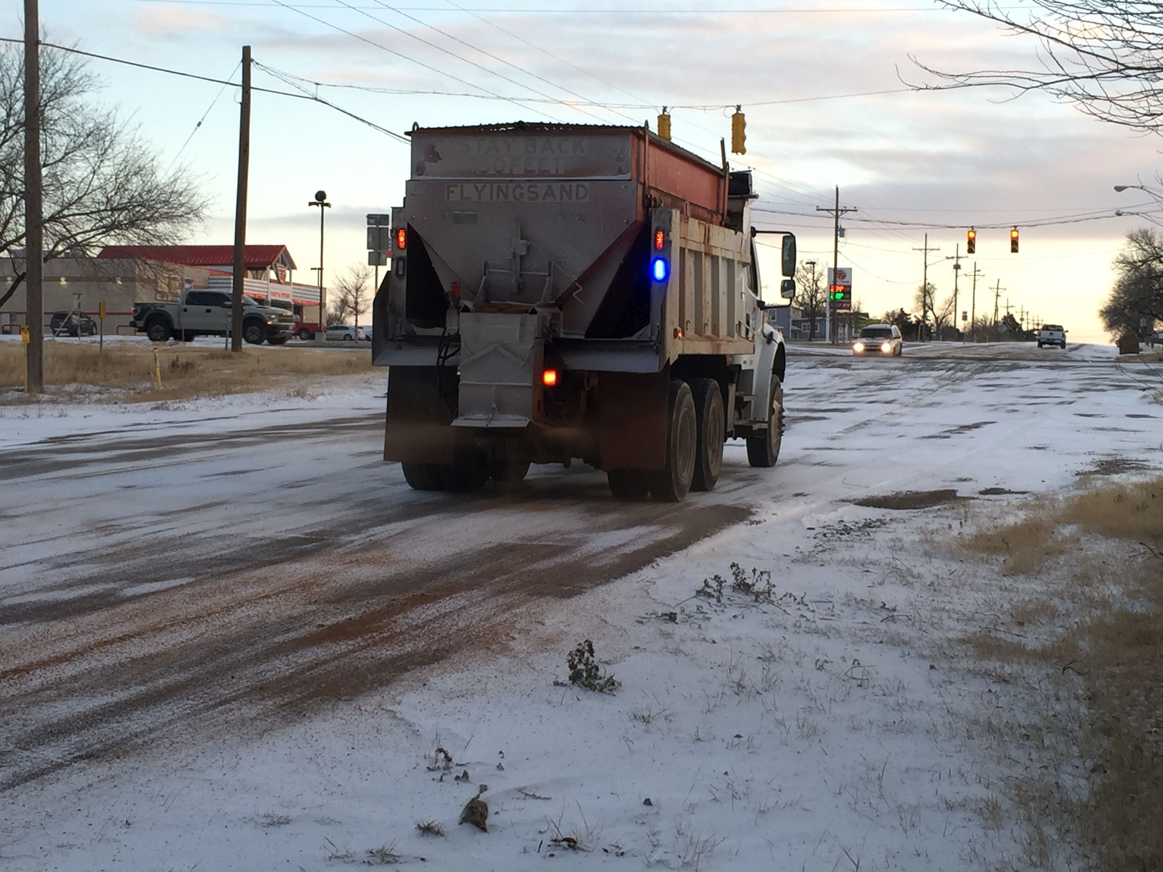

Slide 35
For Winter Operations Subjective Assessment, what service level do you think the City should be targeting?
Please type in a numerical value.
Winter Operations Subjective Assessment
To participate:
PollEv.com/newgen920
or
Text NEWGEN920 to 22333 once to join
Notes:
Poll Title: Do not modify the notes in this section to avoid tampering with the Poll Everywhere activity.
More info at polleverywhere.com/support
For Winter Operations Subjective Assessment, what service level do you think the City should be targeting?
https://www.polleverywhere.com/free_text_polls/H6q6pX4jMNatFwYoc0Ye2

Slide 36
Street Department
Misc. | Street Structure Maintenance & Repair
Employees
0 positions are funded for this subdivision
​Key Activities
Installation and maintenance of street-related structures
Speed bumps – repairs made as needed
Guardrail and crash attenuators – repairs made as needed
ADA ramps – repairs made as needed
Staff’s subjective assessment is that performance is around 40% of potential
Responsive to emergencies, whereas best practice would emphasize routine and preventative maintenance
Street Structure Subjective Assessment

Slide 37
For Street Structure Subjective Assessment, what service level do you think the City should be targeting?
Please type in a numerical value.
Street Structure Subjective Assessment
To participate:
PollEv.com/newgen920
or
Text NEWGEN920 to 22333 once to join
Notes:
Poll Title: Do not modify the notes in this section to avoid tampering with the Poll Everywhere activity.
More info at polleverywhere.com/support
For Street Structure Subjective Assessment, what service level do you think the City should be targeting?
https://www.polleverywhere.com/free_text_polls/l0JNo4ulVmEsx6dtCoMP3

Slide 38
Street Department
Miscellaneous | Utility Cuts
Employees
6 positions are funded for this subdivision
​Key Activities
Utility service line installation in public ROW, and surface repairs
Service line installation for residents
  690 permits issued to City Department for water and sewer service lines
  744 permits issued to other utilities, including Atmos, Excel, AT&T, etc.
Paving surface repair provided by the City for a fee ($40 / sq. yard asphalt, $100 / sq. yard concrete)
8,660 annual manhours
Below average performance reflects staffing challenges
Utility Cut Response Times
Utility Cuts Subjective Assessment

Slide 39
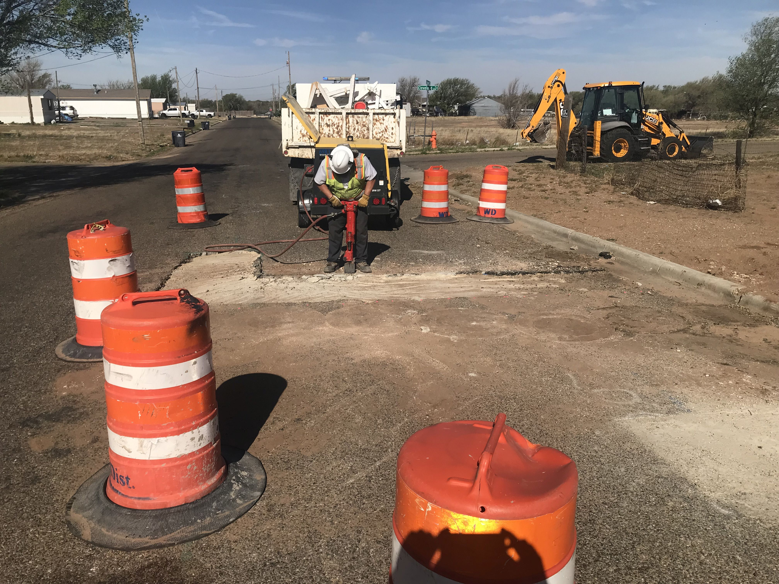

Slide 40
For Utility Cut Response Times, what service level do you think the City should be targeting?
Please type in a numerical value.
Utility Cut Response Times
To participate:
PollEv.com/newgen920
or
Text NEWGEN920 to 22333 once to join
Notes:
Poll Title: Do not modify the notes in this section to avoid tampering with the Poll Everywhere activity.
More info at polleverywhere.com/support
For Utility Cut Response Times, what service level do you think the City should be targeting?
https://www.polleverywhere.com/free_text_polls/7LfuOZ9es61krlRuauIBc

Slide 41
For Utility Cuts Subjective Assessment, what service level do you think the City should be targeting?
Please type in a numerical value.
Utility Cuts Subjective Assessment
To participate:
PollEv.com/newgen920
or
Text NEWGEN920 to 22333 once to join
Notes:
Poll Title: Do not modify the notes in this section to avoid tampering with the Poll Everywhere activity.
More info at polleverywhere.com/support
For Utility Cuts Subjective Assessment, what service level do you think the City should be targeting?
https://www.polleverywhere.com/free_text_polls/f1Hjof1qE1pWkQ8TKZBbh

Slide 42
Power BI Desktop
City of Amarillo – Public Works Department
Overview
PDP

Slide 43
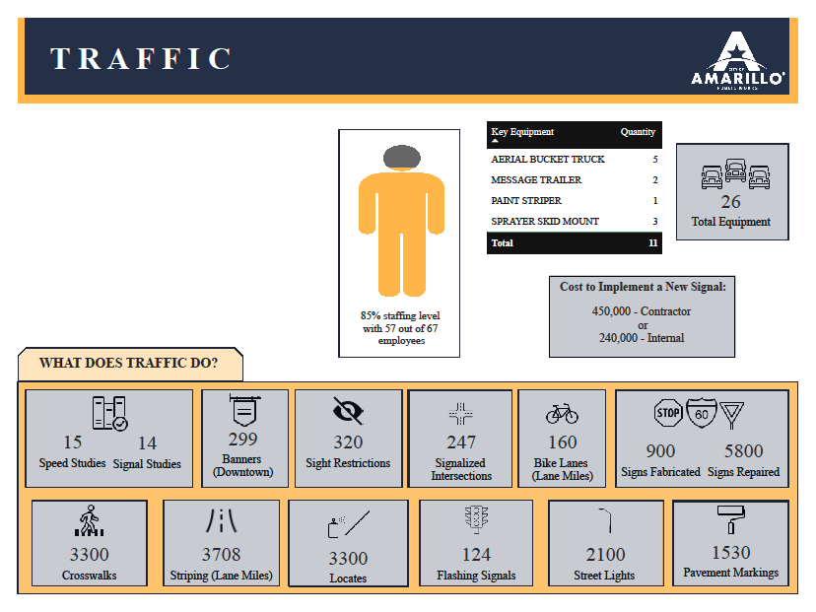

Slide 44
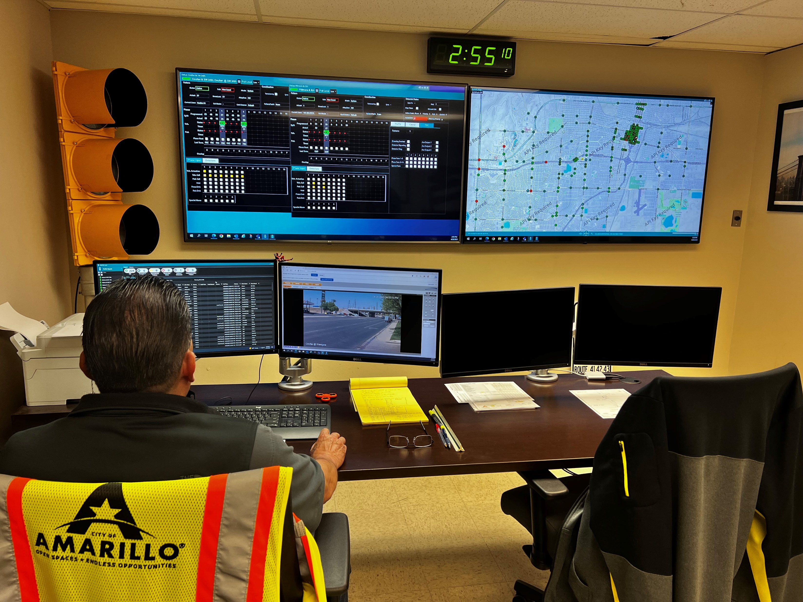
Traffic Management Center

Slide 45
Traffic Department
Budget Categories, FY 2022/23
$6,242,339
Includes a share of costs from the Public Works and CP&DE Departments
Excludes school crossing program
Significant electricity costs for Street Light Maintenance ($2.1m) and Signal Maintenance ($0.7m)

Slide 46
Traffic Department
Traffic Signal Maintenance
Employees
6 positions are funded for this subdivision
​Key Activities
Installation and maintenance of traffic signals and school flashers
  272 intersections maintained
  121 school flashers maintained
New signal cost
  $290,000 City crews
  $425,000 contractors
5% of electronics replaced annually (every 20 years)
  Goal to replace every 7–10 years
  ASHTO recommendation 7 years
Electronics Replacement

Slide 47
For Electronics Replacement, what service level do you think the City should be targeting?
Please type in a numerical value.
Electronics Replacement
To participate:
PollEv.com/newgen920
or
Text NEWGEN920 to 22333 once to join
Notes:
Poll Title: Do not modify the notes in this section to avoid tampering with the Poll Everywhere activity.
More info at polleverywhere.com/support
For Electronics Replacement, what service level do you think the City should be targeting?
https://www.polleverywhere.com/free_text_polls/J5bbrYX2nHfeBOtL7QR2D

Slide 48
Traffic Department
Budget Categories, FY 2022/23
$6,242,339
Includes a share of costs from the Public Works and CP&DE Departments
Excludes school crossing program
Significant electricity costs for Street Light Maintenance ($2.1m) and Signal Maintenance ($0.7m)

Slide 49
Traffic Department
Traffic Sign Maintenance
Employees
3 positions are funded for this subdivision
​Key Activities
Installation and maintenance of traffic signs – 33,000 signs in the City
Average of 1,250 signs replaced annually
Average of over 5,000 signs repaired annually
$135 average sign replacement cost
4% of inventory replaced annually (every 25 years)
  Goal to replace 10% annually (every 10 years)
  ASHTO recommendation to replace signs every 7 years
Sign Replacement

Slide 50
For Sign Replacement, what service level do you think the City should be targeting?
Please type in a numerical value.
Sign Replacement
To participate:
PollEv.com/newgen920
or
Text NEWGEN920 to 22333 once to join
Notes:
Poll Title: Do not modify the notes in this section to avoid tampering with the Poll Everywhere activity.
More info at polleverywhere.com/support
For Sign Replacement, what service level do you think the City should be targeting?
https://www.polleverywhere.com/free_text_polls/c8hBuF9gCJUgbsCGMEiC2

Slide 51
Traffic Department
Budget Categories, FY 2022/23
$6,242,339
Includes a share of costs from the Public Works and CP&DE Departments
Excludes school crossing program
Significant electricity costs for Street Light Maintenance ($2.1m) and Signal Maintenance ($0.7m)

Slide 52
Traffic Department
Street Pavement Markings
Employees
5 positions are funded for this subdivision
​Key Activities
Striping
3,700 lane miles of pavement striping ($9.50 per lane mile)
160 lane miles of bike lanes ($19.65 per lane mile)
Currently replacing 75% per year. Goal is 100%; industry best-practice is 125%.
Pavement Marking
750 crosswalks / stop bars / arrows replaced annually
Goal of full conversion to Thermoplastics
Currently replacing every 8–9 years. Goal is 7 years (the ASHTO recommendation).
Striping Replacement Rate
Pavement Marking Replacement Rate

Slide 53
For Striping Replacement Rate, what service level do you think the City should be targeting?
Please type in a numerical value.
Striping Replacement Rate
To participate:
PollEv.com/newgen920
or
Text NEWGEN920 to 22333 once to join
Notes:
Poll Title: Do not modify the notes in this section to avoid tampering with the Poll Everywhere activity.
More info at polleverywhere.com/support
For Striping Replacement Rate, what service level do you think the City should be targeting?
https://www.polleverywhere.com/free_text_polls/ncYUtnjkqXhWIfENvHO3C

Slide 54
For Pavement Marking Replacement Rate, what service level do you think the City should be targeting?
Please type in a numerical value.
Pavement Marking Replacement Rate
To participate:
PollEv.com/newgen920
or
Text NEWGEN920 to 22333 once to join
Notes:
Poll Title: Do not modify the notes in this section to avoid tampering with the Poll Everywhere activity.
More info at polleverywhere.com/support
For Pavement Marking Replacement Rate, what service level do you think the City should be targeting?
https://www.polleverywhere.com/free_text_polls/lh2H1Wi6YTSlPC3hLkqjD

Slide 55
Traffic Department
Budget Categories, FY 2022/23
$6,242,339
Includes a share of costs from the Public Works and CP&DE Departments
Excludes school crossing program
Significant electricity costs for Street Light Maintenance ($2.1m) and Signal Maintenance ($0.7m)

Slide 56
Traffic Department
Street Light Maintenance
Employees
2 positions are funded for this subdivision
​Key Activities
Installation and maintenance of continuous street illumination on highways, and decorative street lighting in the CBD
2,150 (45% LED) lights maintained on highways
465 lights in CBD
2022 program cost was $2.0 million, of which $1.8 million was electricity
7% of highway lights replaced annually (every 14 years)
  Goal of every 10 years
  Expectation of every 5–7 years
10% of CDB pedestrian lights replaced annually (every 10 years)
  ASHTO recommendation of every 7 years
Highway Light Replacement Frequency
CBD Pedestrian Light Replacement Frequency

Slide 57
For Highway Light Replacement Frequency, what service level do you think the City should be targeting?
Please type in a numerical value.
Highway Light Replacement Frequency
To participate:
PollEv.com/newgen920
or
Text NEWGEN920 to 22333 once to join
Notes:
Poll Title: Do not modify the notes in this section to avoid tampering with the Poll Everywhere activity.
More info at polleverywhere.com/support
For Highway Light Replacement Frequency, what service level do you think the City should be targeting?
https://www.polleverywhere.com/free_text_polls/94y8whi6ddkLKnSoRZJ4Q

Slide 58
For CBD Pedestrian Light Replacement Frequency, what service level do you think the City should be targeting?
Please type in a numerical value.
CBD Pedestrian Light Replacement Frequency
To participate:
PollEv.com/newgen920
or
Text NEWGEN920 to 22333 once to join
Notes:
Poll Title: Do not modify the notes in this section to avoid tampering with the Poll Everywhere activity.
More info at polleverywhere.com/support
For CBD Pedestrian Light Replacement Frequency, what service level do you think the City should be targeting?
https://www.polleverywhere.com/free_text_polls/tUunoMcIAFHT3yX9SA9u3

Slide 59
Traffic Department
Budget Categories, FY 2022/23
$6,242,339
Includes a share of costs from the Public Works and CP&DE Departments
Excludes school crossing program
Significant electricity costs for Street Light Maintenance ($2.1m) and Signal Maintenance ($0.7m)

Slide 60
Traffic Department
Miscellaneous
Employees
A total of 46 positions are funded for this subdivision
​Key Activities
Traffic Administration (1)
Administrative Hearing Officer
No longer funded with the discontinuation of the Red-Light Camera Program
Traffic Engineering (2.25)
Traffic studies – traffic control device, speed and parking studies, with fewer than 10% implemented
  75 studies annually
Development project review – site plans, drive-through, parking standards
  150 plan reviews annually
90% development plans reviewed within the specified time of 10 to 15 days
Plans Reviewed on Time

Slide 61
For Plans Reviewed on Time, what service level do you think the City should be targeting?
Please type in a numerical value.
Plans Reviewed on Time
To participate:
PollEv.com/newgen920
or
Text NEWGEN920 to 22333 once to join
Notes:
Poll Title: Do not modify the notes in this section to avoid tampering with the Poll Everywhere activity.
More info at polleverywhere.com/support
For Plans Reviewed on Time, what service level do you think the City should be targeting?
https://www.polleverywhere.com/free_text_polls/qtx10SejhyqOefW6qMr3s

Slide 62
Traffic Department
Miscellaneous
School Crossing Program (40)
Program is designed to work with Amarillo and Canyon School Districts to assist the crossing of school children on arterial and collector streets
No contractual agreement with either ISD
36 crossing locations
90% of the time crossing manned by dedicated staff
Permits (0.5)
Parade and Block Party permits are issued to ensure that all emergency services are aware of street closures and that parties are following City guidelines
60–70 permits annually
90% of permits reviewed within the specified timeframe
School Crossing Locations Manned
Permits Issued on Time

Slide 63
For School Crossing Locations Manned, what service level do you think the City should be targeting?
Please type in a numerical value.
School Crossing Locations Manned
To participate:
PollEv.com/newgen920
or
Text NEWGEN920 to 22333 once to join
Notes:
Poll Title: Do not modify the notes in this section to avoid tampering with the Poll Everywhere activity.
More info at polleverywhere.com/support
For School Crossing Locations Manned, what service level do you think the City should be targeting?
https://www.polleverywhere.com/free_text_polls/sHwwqUZTg9EV19ZzXZvZJ

Slide 64
For Permits Issued on Time, what service level do you think the City should be targeting?
Please type in a numerical value.
Permits Issued on Time
To participate:
PollEv.com/newgen920
or
Text NEWGEN920 to 22333 once to join
Notes:
Poll Title: Do not modify the notes in this section to avoid tampering with the Poll Everywhere activity.
More info at polleverywhere.com/support
For Permits Issued on Time, what service level do you think the City should be targeting?
https://www.polleverywhere.com/free_text_polls/WmwEDRHqW6ll7HmNwLpWC

Slide 65
Traffic Department
Miscellaneous
Safety Improvements (2)
Traffic Engineering Studies to evaluate locations for new signalized intersections, and to identify intersections to be rebuilt with projected funds for the fiscal year
30–40 studies annually, with the top 20 accident prone intersections evaluated each year
Currently evaluating 15% of total system – best practice is 10%
Sight Restrictions (0.25)
Sight restrictions are obstructions in the line of sight for traffic at an intersection with a stop sign or yield sign
250 Sight Restriction complaints annually
Currently evaluating 100%
Proportion of Traffic System Evaluated
Sight Restrictions Evaluated

Slide 66
For Proportion of Traffic System Evaluated, what service level do you think the City should be targeting?
Please type in a numerical value.
Proportion of Traffic System Evaluated
To participate:
PollEv.com/newgen920
or
Text NEWGEN920 to 22333 once to join
Notes:
Poll Title: Do not modify the notes in this section to avoid tampering with the Poll Everywhere activity.
More info at polleverywhere.com/support
For Proportion of Traffic System Evaluated, what service level do you think the City should be targeting?
https://www.polleverywhere.com/free_text_polls/cGdeNAL8vnvJYsxp67Vn0

Slide 67
For Sight Restrictions Evaluated, what service level do you think the City should be targeting?
Please type in a numerical value.
Sight Restrictions Evaluated
To participate:
PollEv.com/newgen920
or
Text NEWGEN920 to 22333 once to join
Notes:
Poll Title: Do not modify the notes in this section to avoid tampering with the Poll Everywhere activity.
More info at polleverywhere.com/support
For Sight Restrictions Evaluated, what service level do you think the City should be targeting?
https://www.polleverywhere.com/free_text_polls/n16mQ31X64L3lKlO8CkaO

Slide 68
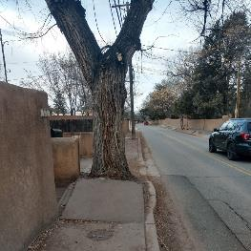
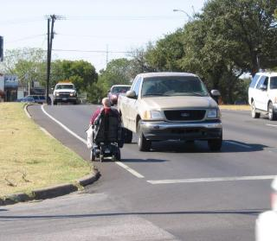
Staff Concerns
Not Covered Infrastructure
  Sidewalks
    Americans with Disabilities Act (ADA) (1990)
      DOJ Implementing Regulations (28 CFR 35)(2010)
      In Texas: Texas Accessibility Standards (TAS) and (TDLR)
    The ADA is a Federal Civil Rights law that prohibits the discrimination against persons with disabilities in all aspects of life.
    State and Local Governments are governed by Title II
      Must ensure that individuals with disabilities are not excluded from programs, services, and activities (pedestrian facilities are an example of a program)
Notes:
Modify this to match our buckets… “paving Misc.”

Slide 69
Staff Concerns
Not Covered Infrastructure
  Sidewalk Tools
    City Ordinance 4-6-187 Maintenance of Sidewalk is the property owner's responsibility.
    Development Policy – we will not accept a subdivision without compliant ADA ramps.
    Missing Piece – Maintenance, typically unwilling to enforce maintenance on private citizens.
  Sidewalk Risk
    Withholding of federal and state funds
    A settlement agreement with the Department of Justice
    Private lawsuits
  Sidewalk Options.
    Best Practice is a Self Evaluation and Transition Plan
    Summary Judgement is 3-5 years
    Transition Plan can be “reasonable to the size of the jurisdiction”
Notes:
Modify this to match our buckets… “paving Misc.”

Slide 70
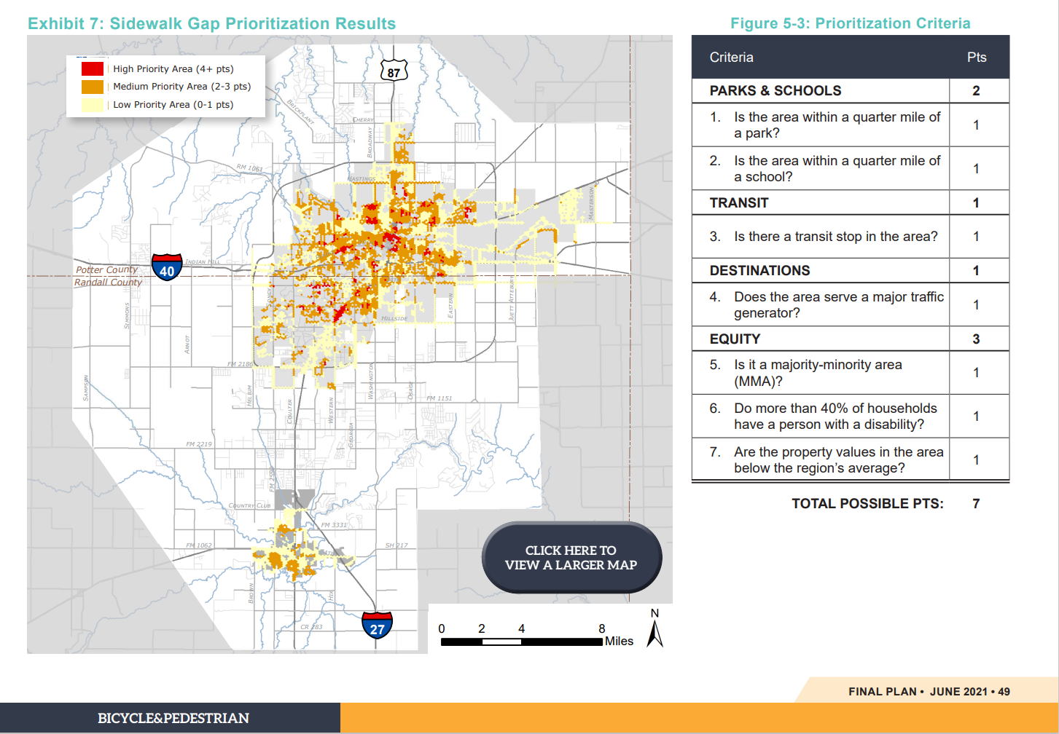
Staff Concerns
Not Covered Infrastructure
Notes:
Modify this to match our buckets… “paving Misc.”

Slide 71
For Sidewalks, what service level do you think the City should be targeting?
Please rank the following statements. 1 being the statement you most support and 4 being the statement you least support.
    The City should continue managing the maintenance of public sidewalks the way it currently does.
    The City should manage the maintenance of public sidewalks with its existing ordinances and enforce compliance thru fines and/or assessments of the adjacent property owners.
    The City should establish a proactive plan to address sidewalk maintenance and enforce compliance with that plan thru fines and/or assessments of the adjacent property owners.
    The City should establish a proactive plan to address sidewalk maintenance and establish a dedicated funding source to achieve that plan.
Notes:
Modify this to match our buckets… “paving Misc.”

Slide 72
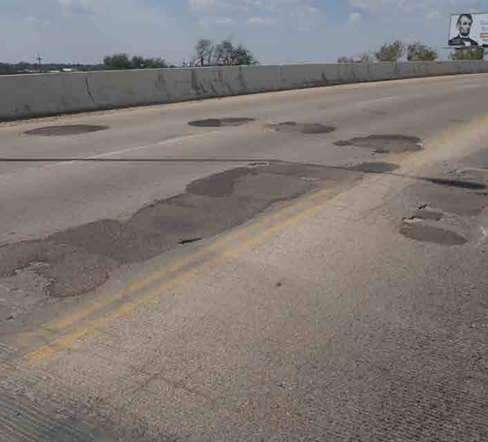
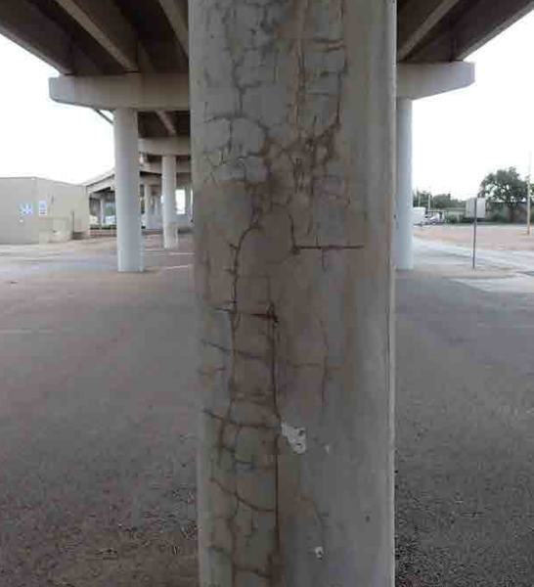
Staff Concerns
Not Covered Infrastructure
  Bridge Maintenance
    TXDOT inspects all bridges and gives a safety classification.
      Statewide Call for projects in Funding Categories
        Bridge Preventative Maintenance (BPM)
        Bridge Maintenance and Improvement Program (BMIP)
        Highway Bridge Program (HBP)
    Must have Deficient Rating to compete.
    Best Practice is to do routine local maintenance to extent the life of a very costly investment.
Notes:
Modify this to match our buckets… “paving Misc.”

Slide 73
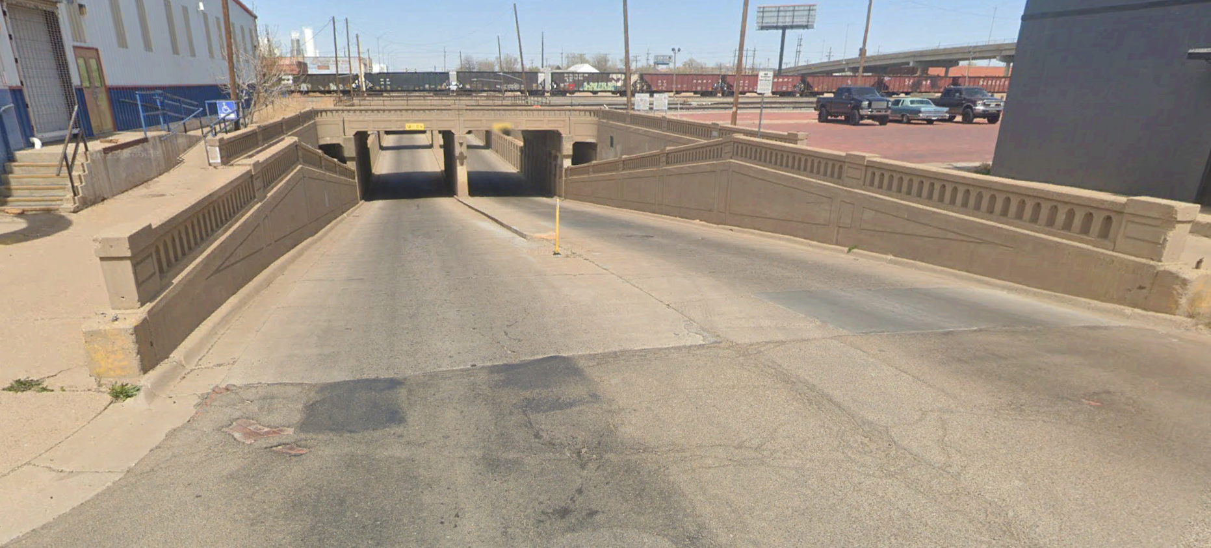
Staff Concerns
Not Covered Infrastructure
  Not Covered
    Railroad Bridges with “City Underpasses”.
      3rd Street, 10th Street, 26th Street, Buchanan, Fillmore
    Railroad inspects what they feel impacts their safety. No reports generated for City use.
    Railroad states the City owns the sub-structure.
Notes:
Modify this to match our buckets… “paving Misc.”

Slide 74
For Bridges, what service level do you think the City should be targeting?
Please rank the following statements. 1 being the statement you most support and 4 being the statement you least support.
    The City should continue managing the maintenance of bridges the way it currently does.
    The City should take a more active role in the maintenance of bridges by completing maintenance items identified by TxDOT inspections with City Staff.
    The City should take a proactive role in the maintenance of bridges by completing maintenance and repair items identified by TxDOT inspections with City Staff and Capital Funding.
Notes:
Modify this to match our buckets… “paving Misc.”

Slide 75
For Bridges, what service level do you think the City should be targeting?
Please rank the following statements. 1 being the statement you most support and 4 being the statement you least support.
    The City should react to maintenance items of underpass bridges as they occur.
    The City should take an active role in the maintenance of underpass bridges by completing maintenance items identified with City Staff.
    The City should take a proactive role in the maintenance of underpass bridges by completing a periodic inspection report and completing maintenance.
    The City should take a proactive role in the maintenance of underpass bridges by completing a periodic inspection report, completing maintenance items identified and actively identify future capital expenditures including eventual replacement.
Notes:
Modify this to match our buckets… “paving Misc.”

Slide 76
Input & Discussion
…
What's Next
Here is what we were going to do with this information.
Overall Grade for Street department
Overall Grade for Traffic department
Rank importance of the Street Categories
Rank importance of the Traffic Categories
Verify what we heard from you
Update Council
Funding Methodology…

Slide 77
Street Funding Discussion
THANK YOU!

