Slide 1
Street Funding Discussion
Funding Future and Maintaining Existing Streets
Kyle Schniederjan
Director of Capital Projects and Development Engineering
March 23, 2023

Slide 2

Agenda
Goals and Objectives
Broad General Fund Items
Broad Enterprise Fund Items
Streets Infrastructure Funding (PDP Recap)
Group Discussion

Slide 3
Goals and Objectives– Why are we here?
Explore Funding Strategies to Construct Future Streets and Maintain Existing Streets
Consider Funding Options
  Typical Municipal General Fund
  Enterprise Fund
  Tax Based vs. Fee Based
  Funding for RR&R, Maintenance, Operations and Growth
Consider Levels of Service
  Arterial Streets
  Residential Streets
  Alleys
  Street Signs and Public Messaging
  Traffic Signals
  Bridges
  State and Federal Participation Requirements
Other Policy Considerations
  Development Policy Questions
  Exemptions
  Rate
Policy Recommendations

Slide 4
Municipal Funding Tools
Property Tax
  Conventional Property Tax Charge Per The Value Of Property Inside City Limits. $0.40628 / $100 valuation
  Exemptions Apply
    Governmental including I.S.D.
    Religious
    Tax Freeze
  Can Be Specifically Allocated By Governing Body But Typically Not.
  Currently 23% of the General Fund
Sales Tax
  Conventional Purchase Tax On Purchases Within The City Limits. 8.25% - 6.25% State and 2% City
  Exemptions Apply
    Governmental including I.S.D.
    Religious or otherwise exempt organizations
    Food and other non-tax goods
  Can Be Specifically Allocated By Governing Body
    1% General Funding and EDC 0.5% and 0.5% to reduce property tax
  Currently 32% of the General Fund
Notes:
Parks - $3.4 M from FY 21-22 Tax increase
Streets - $687,000
Streets - $750,000

Slide 5
Enterprise Funding
Service Based Fee
  Utilities, Drainage, Airport
  Consumption Dependent – Variable Revenue
  Exemptions Can Apply if Established
    Governmental – Parks Department
    No Religious Exemption for City of Amarillo Drainage Utility Fee
Impact Fees
  City of Amarillo does not currently utilize this funding tool.
  Highly Regulated at the State Level.
  Only for proportional infrastructure growth related expenditures.
    Water, Sewer, Drainage, Streets

Slide 6
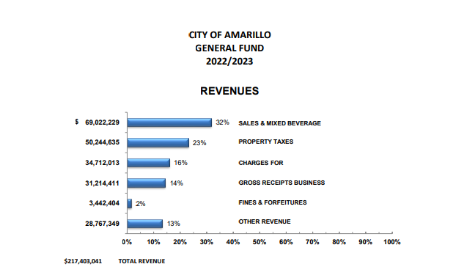
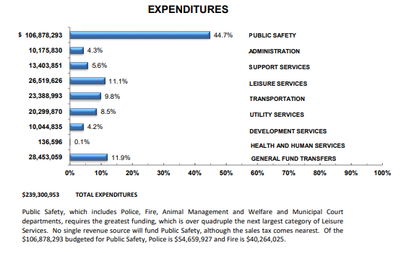
Transportation Funding**
Currently Tax Based Funding
2022-2023 Annual Budget - $490.8 Million
  General Fund - $217.4 Million forecasted Revenue
  General Fund - $239.3 Million forecasted Expenditures
Notes:
Get Laura’s Talking Points of the gap between the two.
We want to be conservative in our revenue expectations. Capital Vs. Budget $
Staffing levels and higher than predicted sales tax revenues.
Spending down reserves from previous years to the minimum policy levels. (90 Day Operating Reserve)
Airport is enterprise
Transit makes its own money and gets grants.

Slide 7
Transportation Funding - FY 22-23
  General Fund Expenditures- $239.3 Million
    Transportation - $23,388,993
      Street Department = $11,108,668
      Traffic Administration = $5,545,263
      Transit Departments = $6,735,057
    Development Services – $10,044,835
      Public Works (direct & indirect) = $556,828 x 25% = $140,000
      CP&DE (direct & indirect) = $1,326,811 x 67% = $884,540
      Planning, Building Safety, Environmental Health, Fire Marshal = $8,161,196
    General Fund Transfers - $28,453,059
      Street Improvement Fund Capital Projects = $2,587,000
      Reconstruction of 5th Street and Bowie Street = $1,000,000
  Transportation Infrastructure Funding Total = $21,265,471
Notes:
Transfers include internal revenue sources such as IT and Fleet, as well as rolled over previous years savings into one time capital projects.

Slide 8
Transportation Funding
Transportation Infrastructure Funding Total = $21,265,471
  Operations = 12%? (performing analysis now)
  Maintenance = 75%? (performing analysis now)
  Rehab Repair & Replacement vs. Growth (13% capital) = $3,587,000
Equivalent Tax Based Funding for $21.2 M =
  $0.15 Property Tax Rate per $100 value.
  29% Sales Tax Revenue from FY 22-23.
Equivalent Fee Based Funding for $21.2 M =
  (73,000 water meters) = $275 per year or $23 per month.
  Tiered system based on Vehicle Trip Rating = $4 to $10 per month residential and $45 to multiple thousand.
Notes:
Residential and Commercial Challenge

Slide 9
Transportation Funding
Current Years Funding $21,265,471
Identified Needs
  2017 Street Assessment
    Average Pavement Condition Index (PCI) is 69.15
    Most popular scenario was to increase Average PCI to 75 and maintain that level of service.
    In 2017 dollars it was estimated to require $245 Million (maintenance and RRR) to achieve a PCI of 75 and approximately $35 Million annual maintenance dollars to keep it.
Notes:
Rough Numbers:
35 Million = $40 per month per water meter…
Bond for 245 M Debt payment is 15M per year = another $20 per month

Slide 10
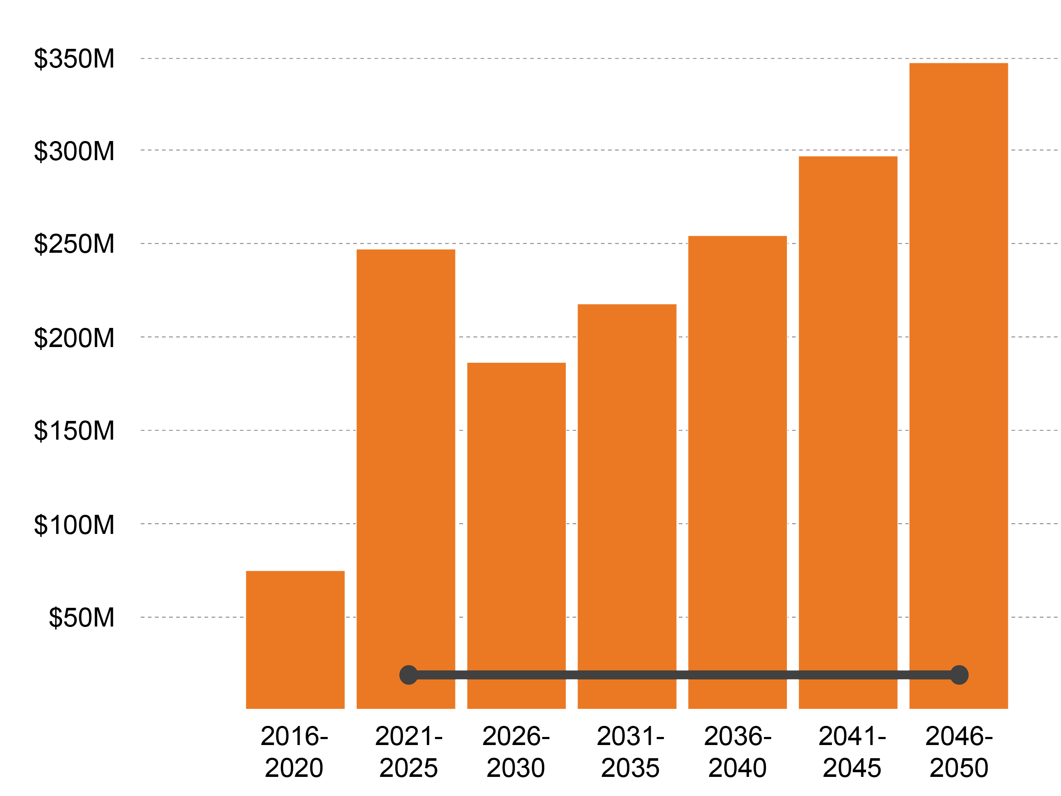
What does future infrastructure funding for Streets look like?
Revenue with 3.5% Annual Growth
Streets
Notes:
Not the target but only if we have a money tree!
We have to find a compromise somewhere… we may not get to this

Slide 11
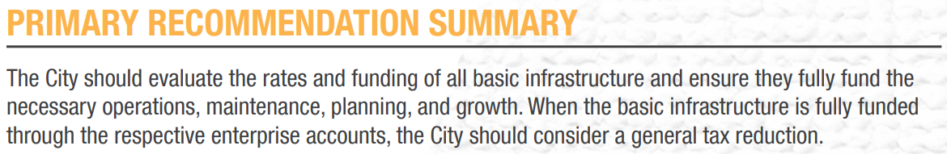
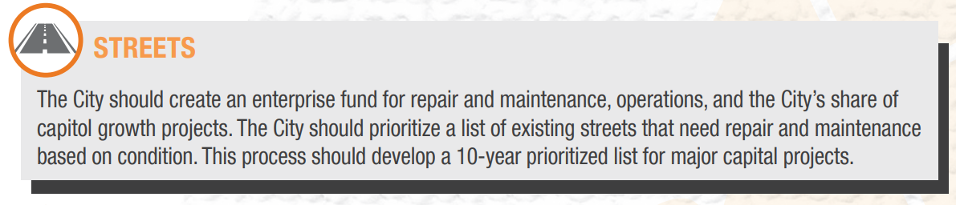
Notes:
General Fund Transfer
Not asking you to solve this from implementation.
???TAX Reduction??? Must be tied to Service Level!!

Slide 12
Next Steps
Anticipated Schedule
Wednesday, February 8, 2023 |  | Intro, Roles, Expectations
Wednesday, February 15, 2023 |  | Open for internal or staff meetings
Thursday, February 23, 2023 |  | City staff Meets with New Gen durring the day
Thursday, March 23, 2023 |  | Funding Basics and Options – General vs. Enterprise
Wednesday, April 5, 2023 |  | Level of Service Part 1
Thursday, April 6, 2023 |  | Levels of Service Part 2
Thursday, April 27, 2023 |  | Funding Structure
Thursday, May 11, 2023 |  | What is Included?
Thursday, May 25, 2023 |  | Costs Recap and Fee Basics
Thursday, June 8, 2023 |  | Fee Options & Discounts
Thursday, June 15, 2023 |  | Proposed Implementation Methods
Tuesday, June 27, 2023 |  | Council Update
 |  | Billing Database Development
Tuesday, October 10, 2023 |  | Council UPdate
 |  | Billing Implimentation Plan
 |  | Ordinance Development
Tuesday, December 12, 2023 |  | Council Consideration

Slide 13
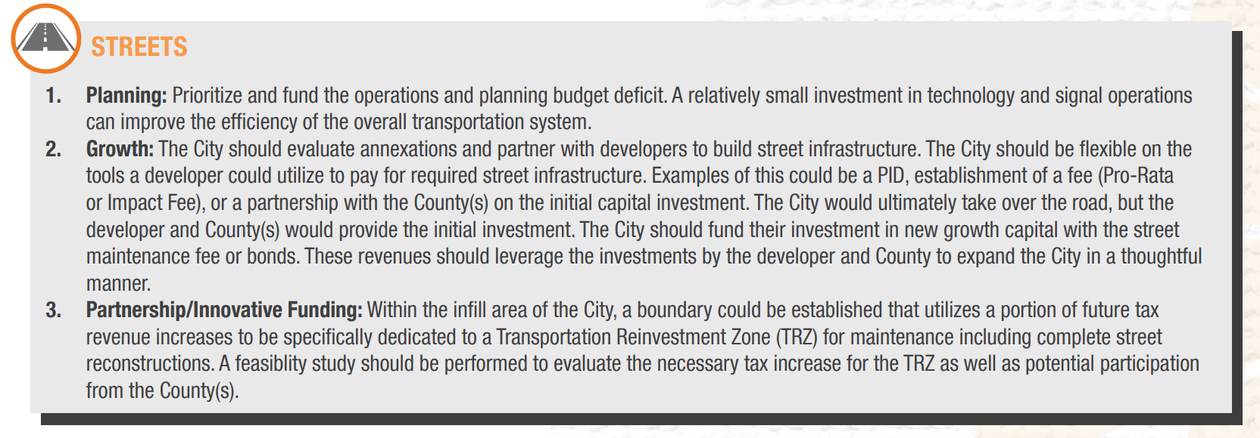
Notes:
General Fund Transfer
First Five Year from DTS recommendation to increase PCI to 75. Future years the Maintenance Budget Proposed to maintain a 75 PCI (35M) and an inflation factor of 3.16%
Not asking you to solve this from implementation.

