Slide 1
Street Funding Discussion
Funding Future and Maintaining Existing Streets
Kyle Schniederjan
Director of Capital Projects and Development Engineering
January 31, 2023

Slide 2

Agenda
City of Amarillo Asset Management
Infrastructure Funding (PDP Recap)
Why are we creating this Citizens group - Directives to Focus on Streets
Goals and Objectives
What are we asking of you
Commitment to Participate

Slide 3
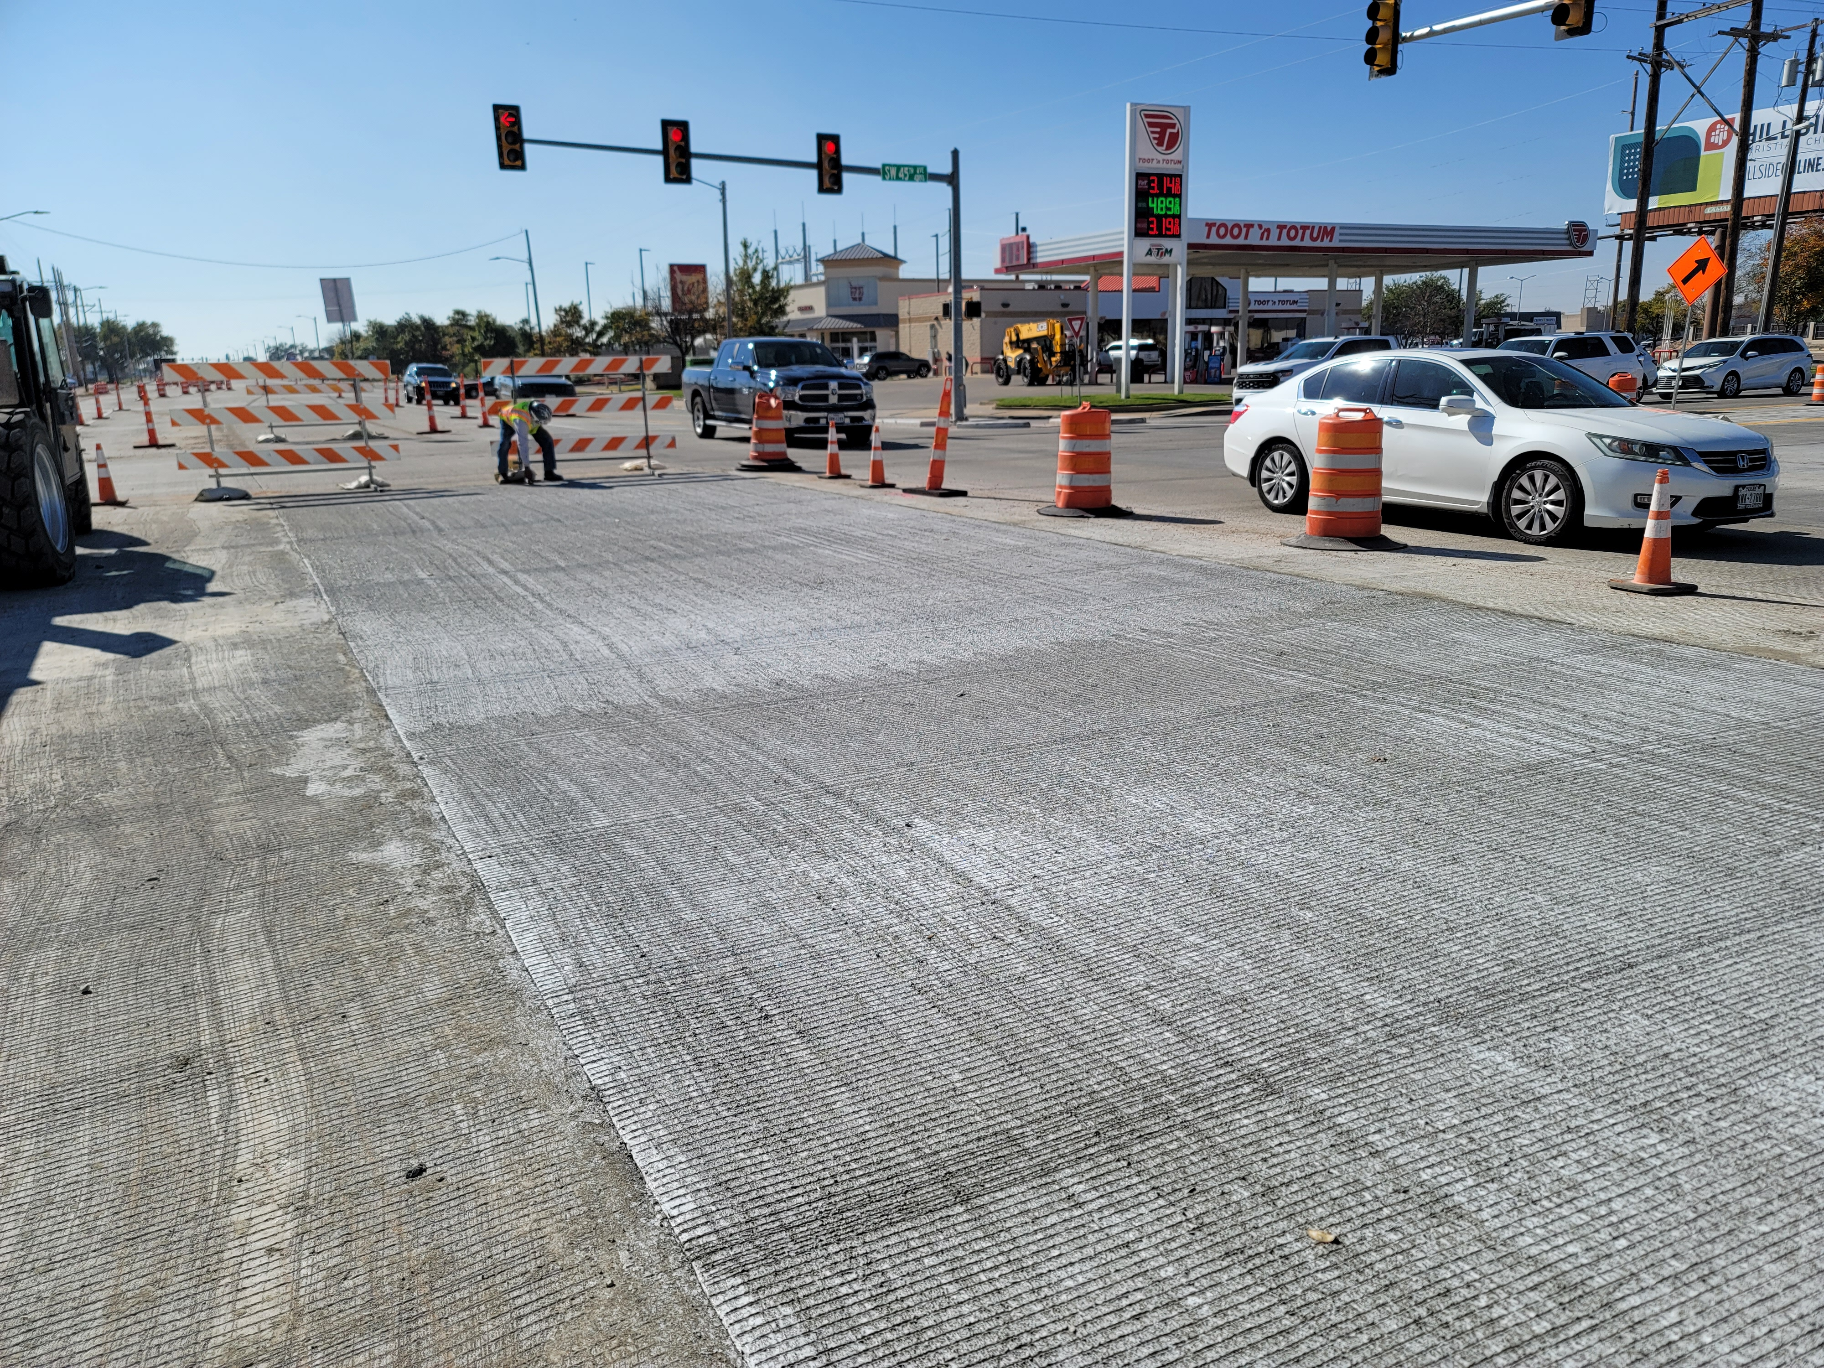
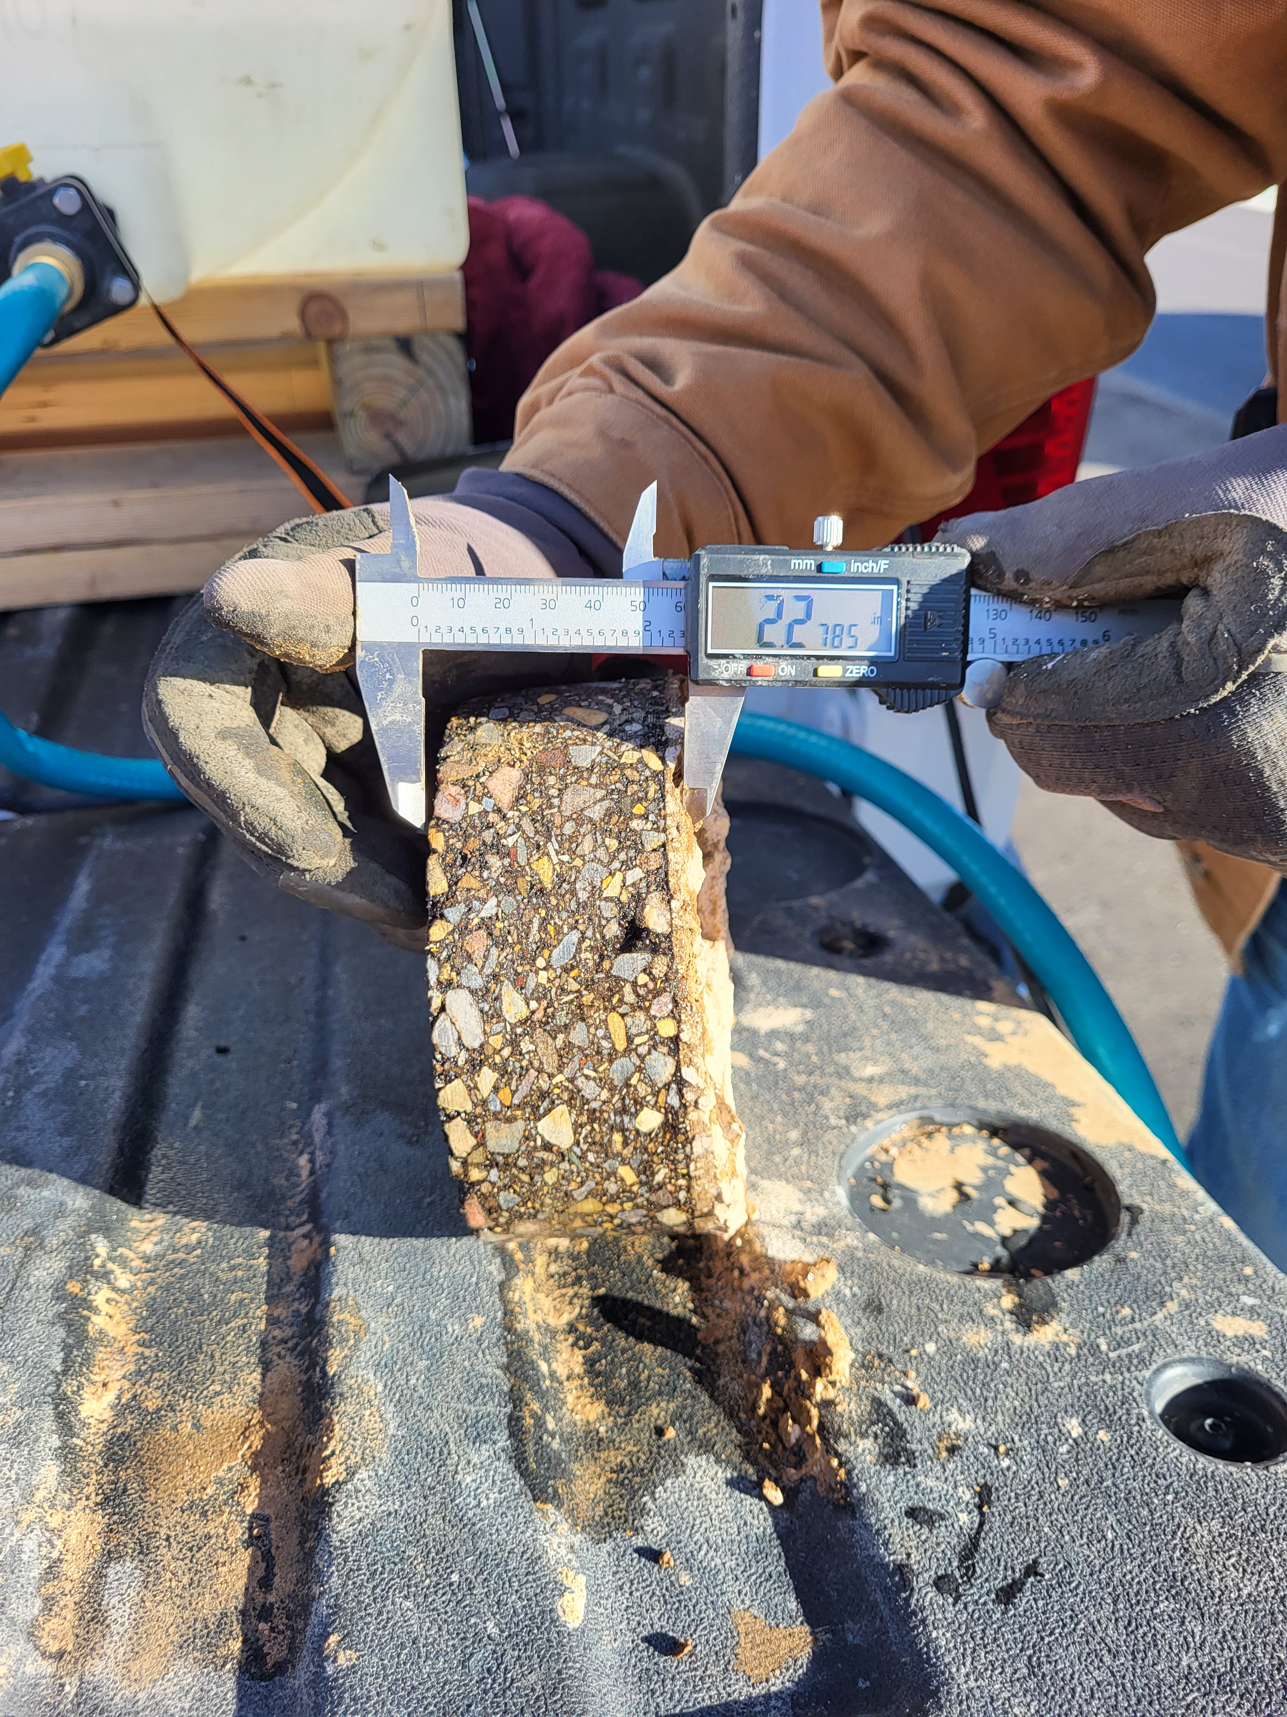
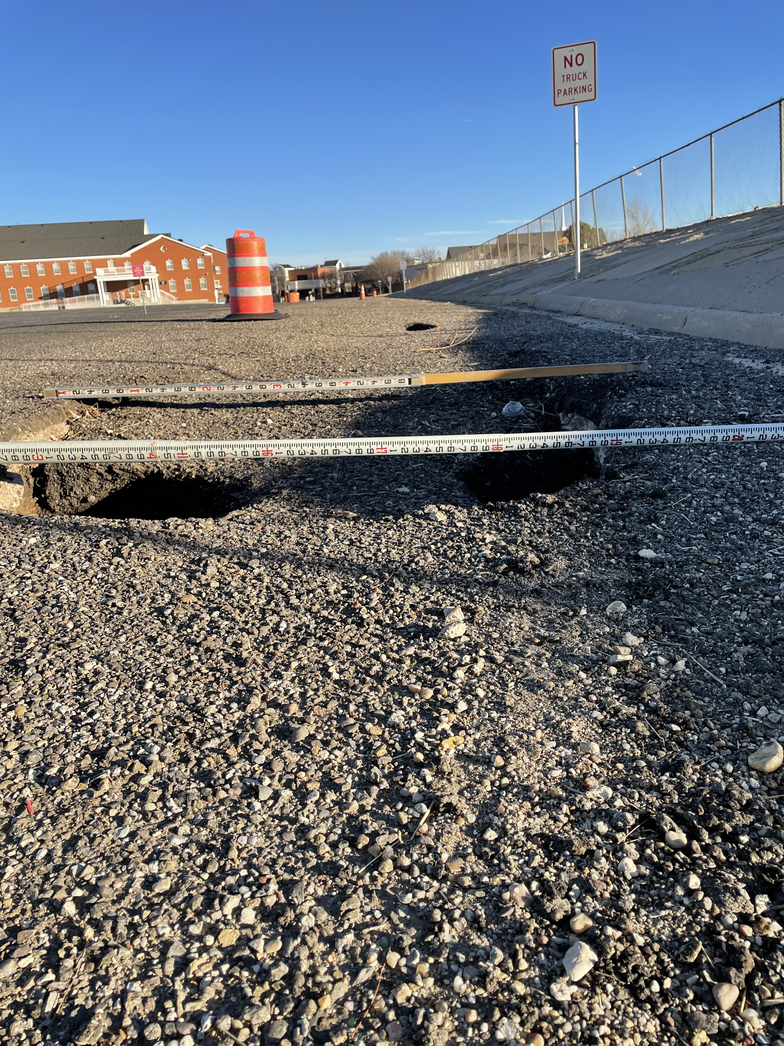
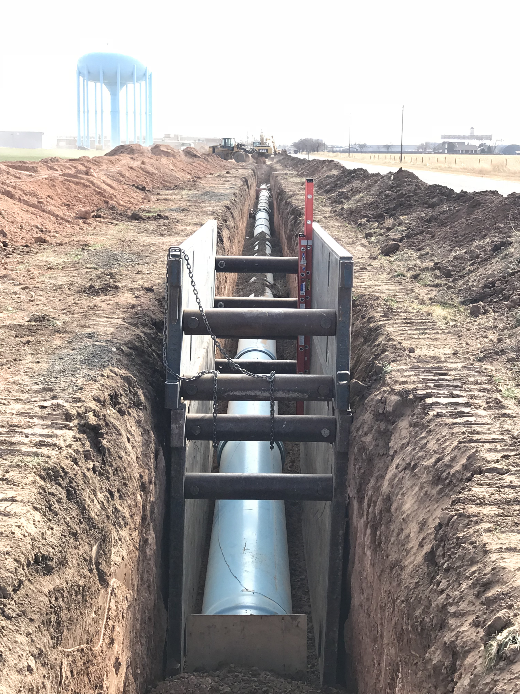
Introductions
What is CP&D Engineering - Established 2016
  Capital Projects and Development Engineering
  Internal Engineering Consulting Firm
  The CIP (Community Investment Program)

Slide 4
Capital Investment Planning
CIP (Community Investment Program) Established 2016
  Every Department Submits Projects (about 25)
  Year One is Fiscally Constrained by the Proposed Budget (50M)
  Years Two thru Five are Fiscally Constrained by Standard Practices – Proposed Bonds, TWDB Loans (110M)
  Years Six and Beyond Should Not Be Fiscally Constrained (>1B)
Product of Departmental Asset Management Plan
Foundation of City’s Asset Management Plan

Slide 5
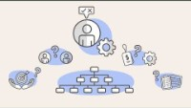
Infrastructure Funding Starts with Asset Management

Slide 6
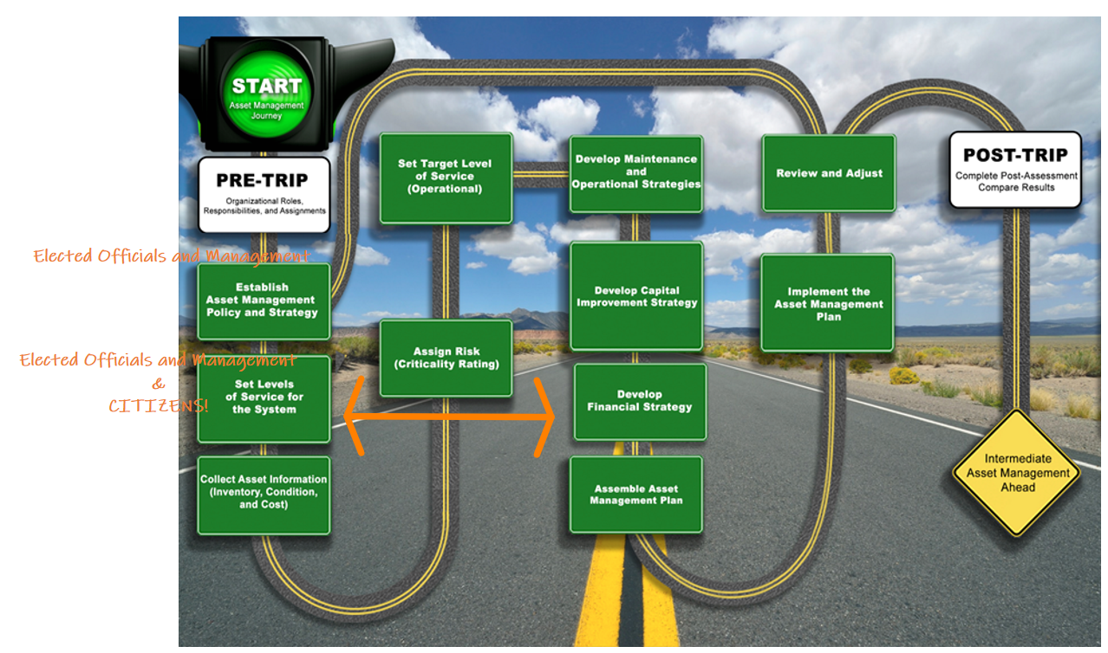
APWA - Asset Management Roadmap

Slide 7
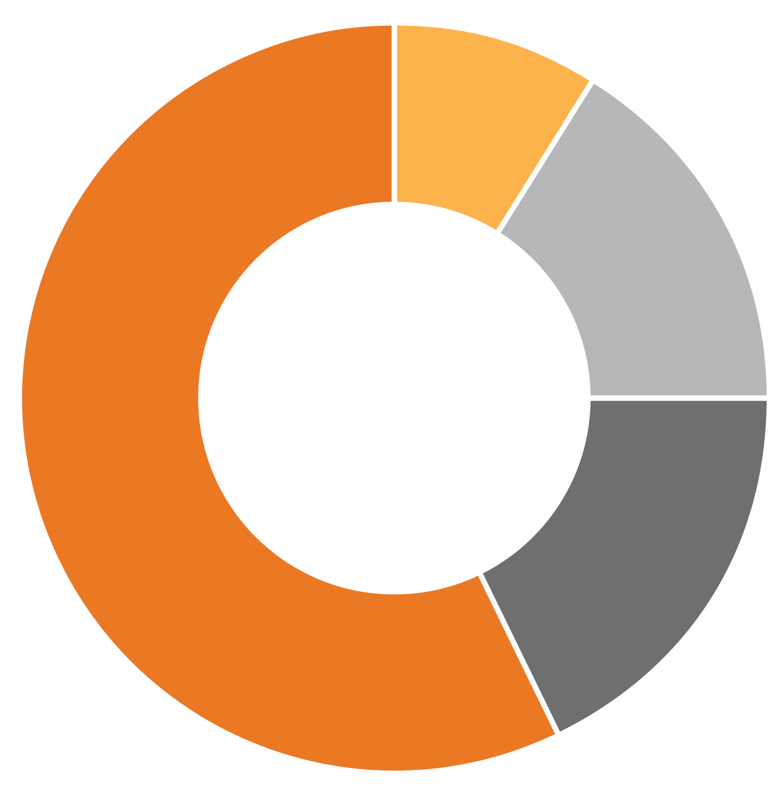
Infrastructure funding distributed over the last 10 years
Developer’s Cost
9%
$117,250,000
City’s Operations & Maintenance Cost
57%
$728,086,000
City’s Growth Capital Cost
17%
$215,833,000
Total is
$1,269,212,000
(2010-2020)
City’s Rehab, Repair & Replace Costs
17%
$208,043,000
Notes:
To answer question number 1 –
#1 What is the cost breakdown for infrastructure funding;
Developer’s Costs and City’s Costs?
First I zoomed out for good context previous ten completed years.
Infrastructure: Water, Sewer, Drainage, Streets
Development: Developers Costs • Subdivision regulation requirements • Developer must construct on-site infrastructure to serve the development.
Growth Capital: Capital projects to expand the system to serve growth, City’s Cost • Reactive – Just in time model, reaching regulatory limits, piecemealed design, first come first served. • Proactive – Master Planning allows for upsizing development and RRR projects.
Rehab, Repair, and Replace(RRR) Capital: End of Life Costs on the system, City’s Cost • Includes predictable and emergency costs, should budget for inflation and growth, (opinion)should be prioritized over and/or not compete with growth capital.
Operations & Maintenance: Repetitive Operational Costs, City’s Cost • O&M Department budgeted projects and internal work, fire hydrant replacement, traffic signals, potholes
Now having some context… lets zoom in

Slide 8
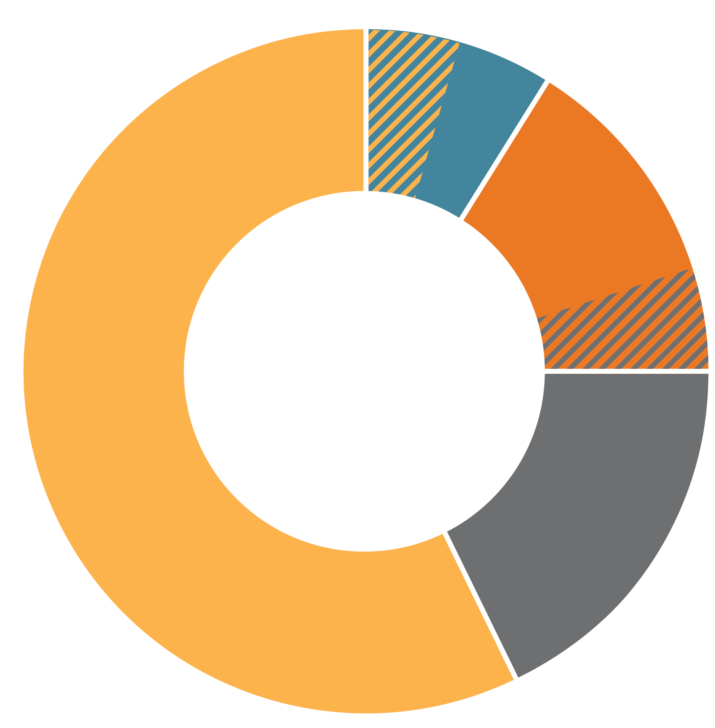
The Issue
WWTP Capacity Upgrades
Growth infrastructure is changing from system extensions to system upgrades…
Maintenance and RRR costs that have been deferred are increasingly competing for the same dollars.
Growth Capital Funding is reduced
How do we pay for Growth infrastructure?
Developer’s Cost
City’s Operations & Maintenance Cost
City’s Growth Capital Cost
Arterial & Drainage End of Life Reconstruction
Amarillo – Ten Years of Basic Infrastructure Funding
(2010-2020)
City’s Rehab, Repair & Replace Costs
Growth Capital Funding is reduced
Notes:
If we remove the numbers and think conceptually.
Meghan Zeigler-
Big picture wrap-up to question #1.
Pause for Questions…

Slide 9
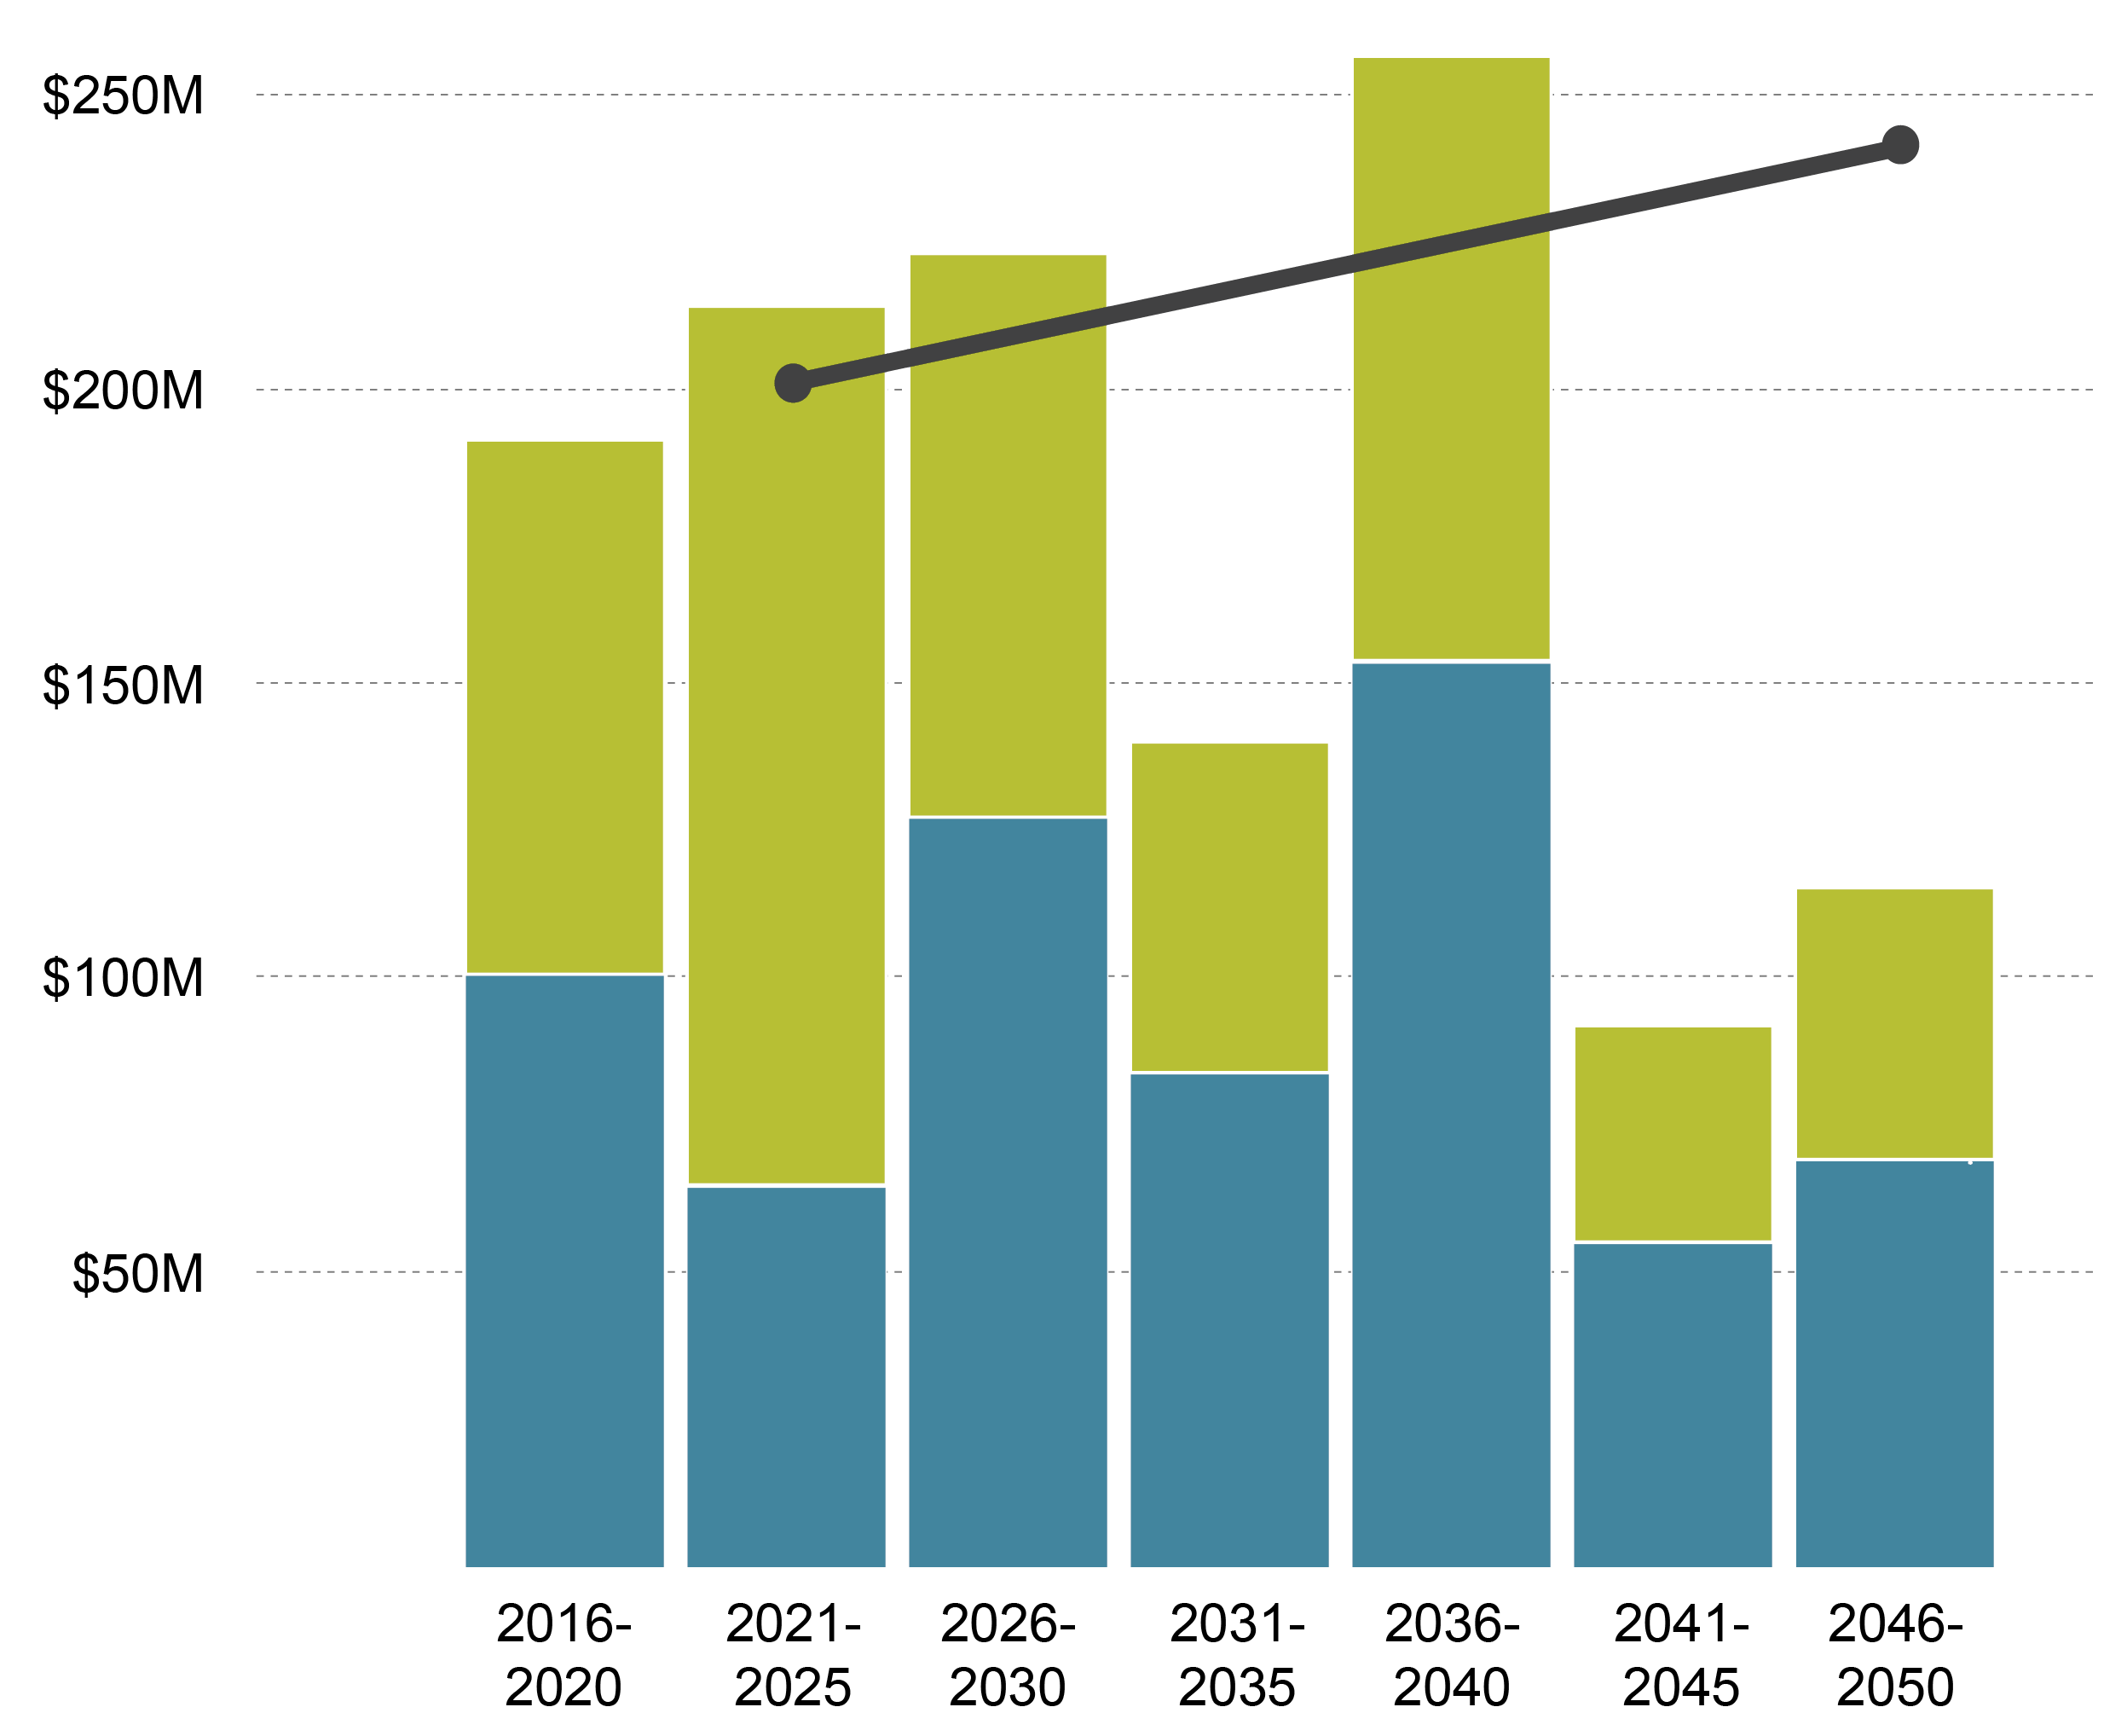
What does future infrastructure funding for Water and Sewer look like?
$102.1M
$95.3M
$148.5M
$90.3M
$55.9M
$153.2M
$127.1M
$45M
$100.9M
$36.6M
$83.9M
$64.5M
$69M
$54.9M
Revenue with 3.5% Annual Growth
Sewer
Water
Notes:
This is total Revenue – Cant use it 100% for Capital
Doesn’t account for expansion that is dramatically different than what we have seen in the past.
Does account for Growth Spending – It is not the same Growth Spending of the previous two decades.

Slide 10
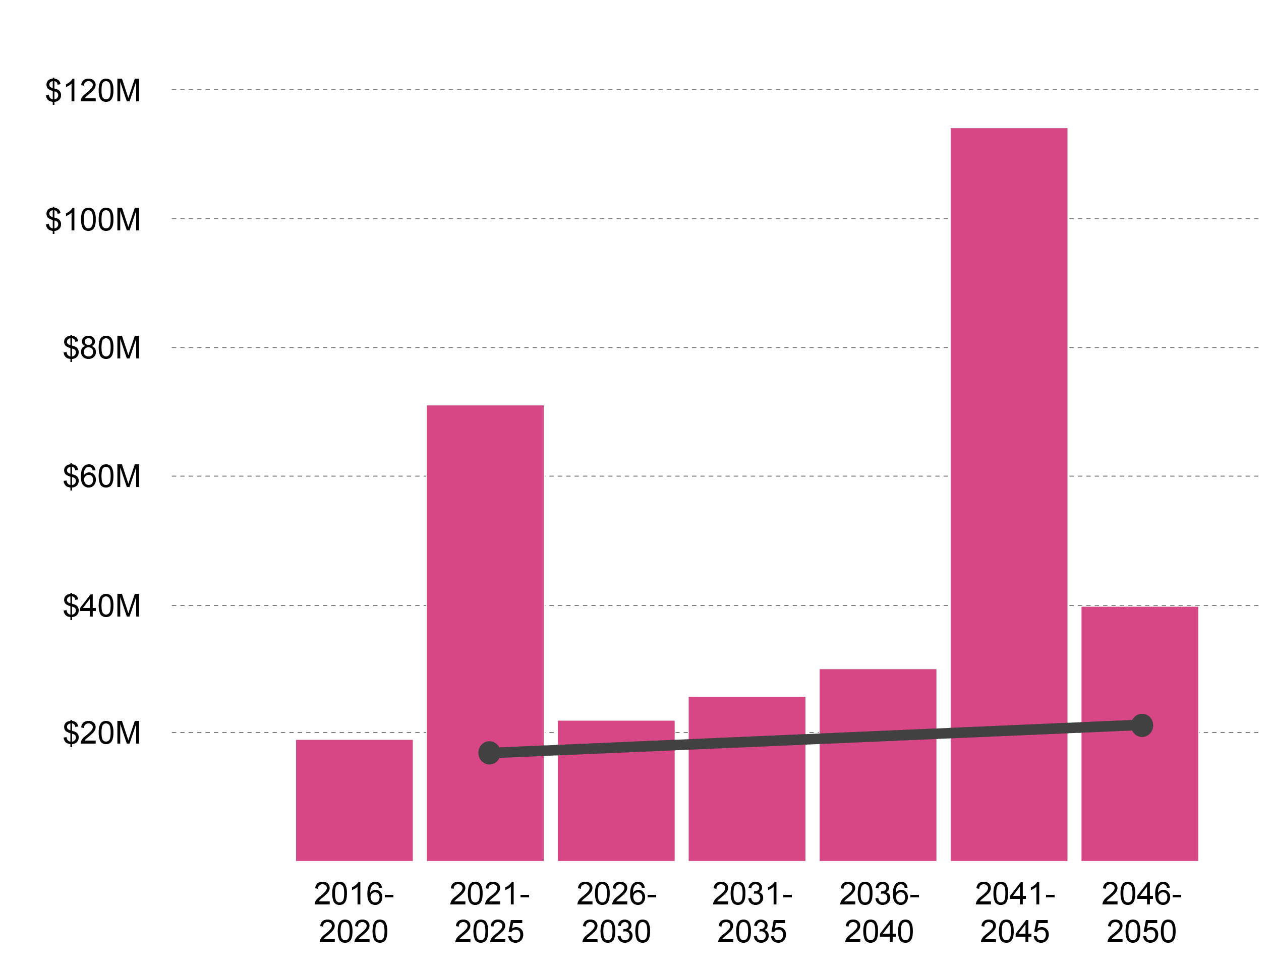
What does future infrastructure funding for Drainage look like?
$114M
$71M
$39.6M
$29.9M
$21.9M
$25.6M
$19M
Revenue with 3.5% Annual Growth
Drainage
Notes:
Master Plan bond option:
Complete an initial project list up front with a BOND
Increase the capital budget to 4M per year. Annual inflation of 3.16% starting in FY25/26. Total Capital list completed by 2030/31

Slide 11
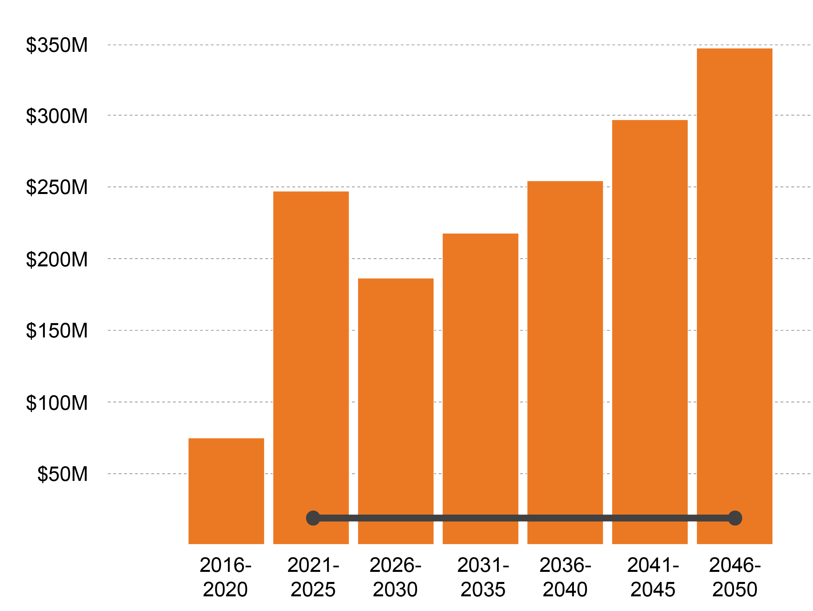
What does future infrastructure funding for Streets look like?
$347.3M
$297.2M
$247.2M
$254.4M
$217.7M
$186.4M
$74.4M
Revenue with 3.5% Annual Growth
Streets
Notes:
General Fund Transfer
First Five Year from DTS recommendation to increase PCI to 75. Future years the Maintenance Budget Proposed to maintain a 75 PCI (35M) and an inflation factor of 3.16%
Not asking you to solve this from implementation.

Slide 12
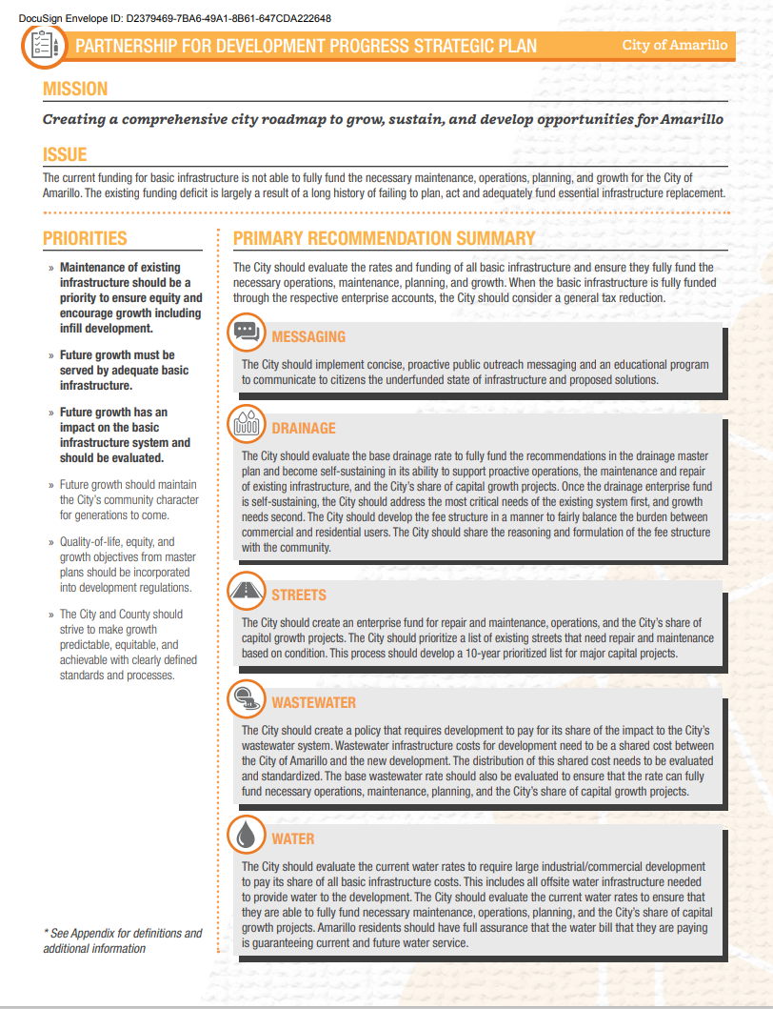
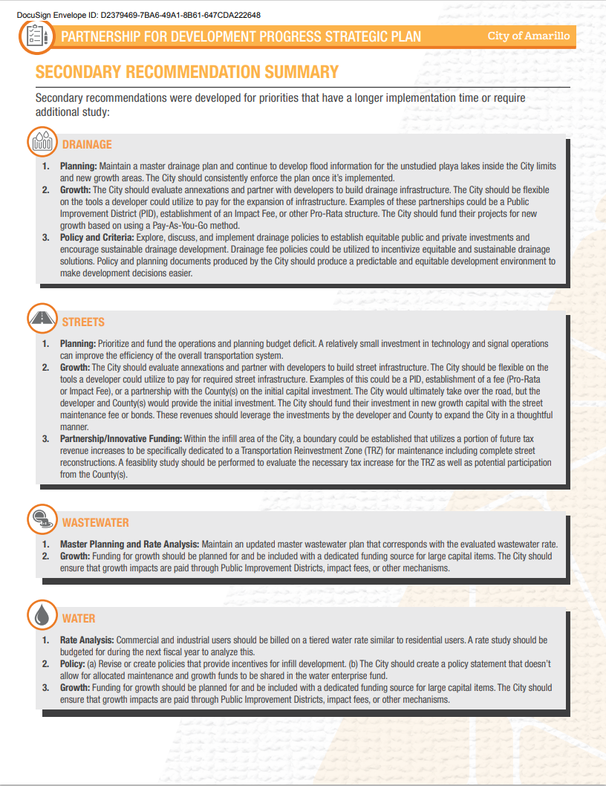
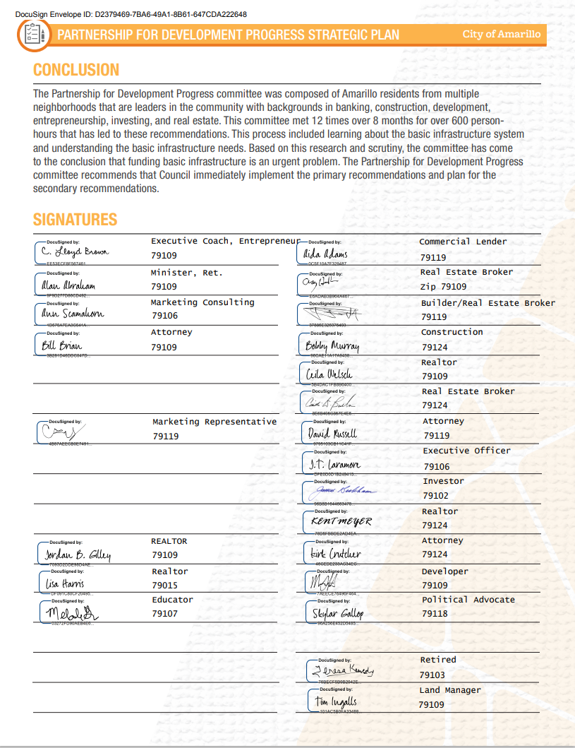
Notes:
General Fund Transfer
First Five Year from DTS recommendation to increase PCI to 75. Future years the Maintenance Budget Proposed to maintain a 75 PCI (35M) and an inflation factor of 3.16%
Not asking you to solve this from implementation.

Slide 13
Notes:
General Fund Transfer
First Five Year from DTS recommendation to increase PCI to 75. Future years the Maintenance Budget Proposed to maintain a 75 PCI (35M) and an inflation factor of 3.16%
Not asking you to solve this from implementation.

Slide 14
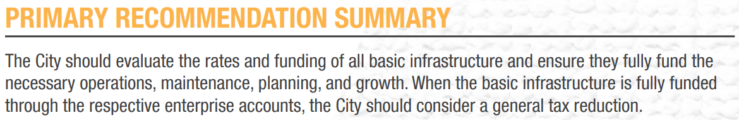
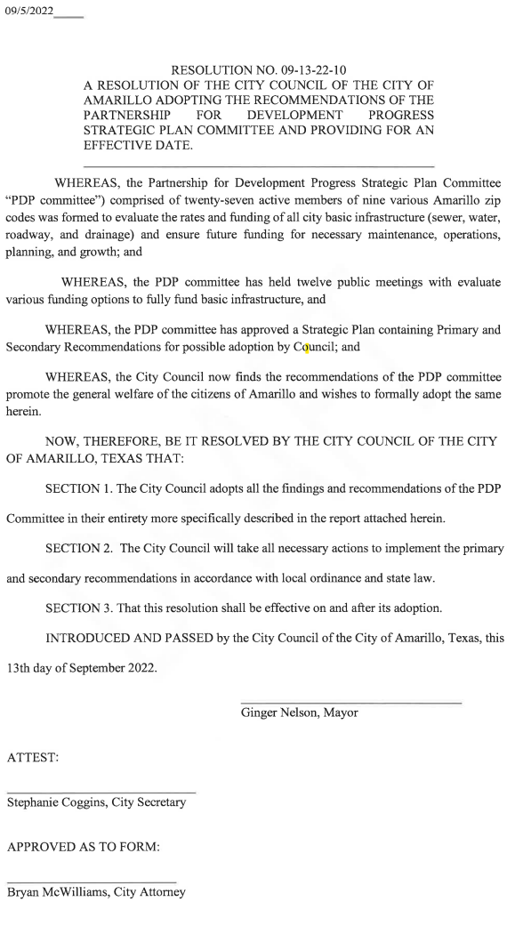
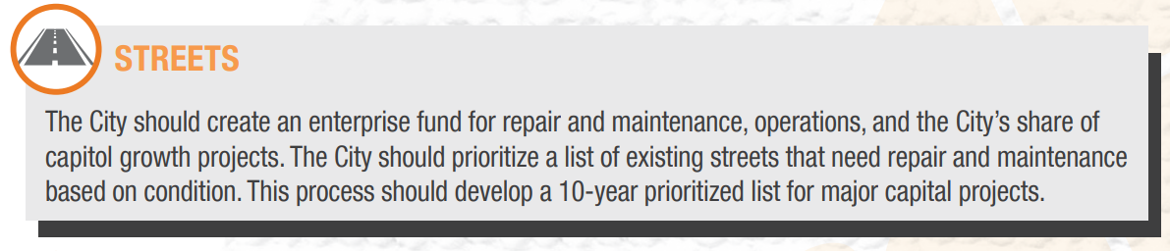
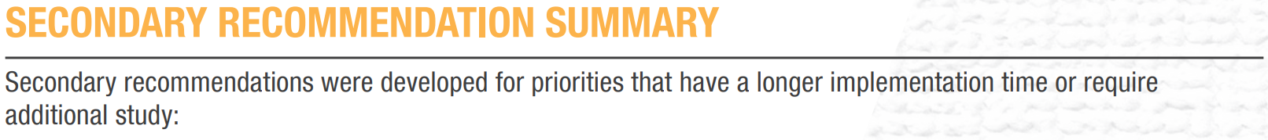
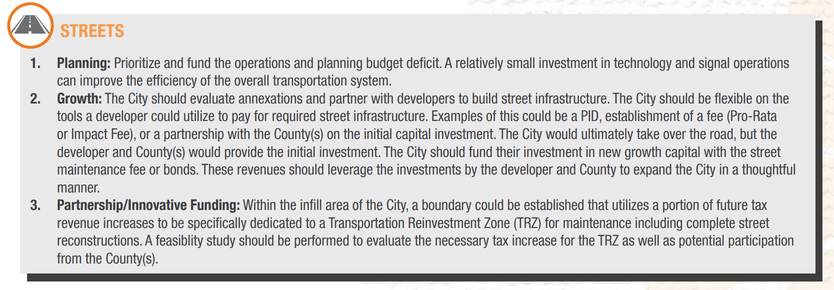
Notes:
General Fund Transfer
First Five Year from DTS recommendation to increase PCI to 75. Future years the Maintenance Budget Proposed to maintain a 75 PCI (35M) and an inflation factor of 3.16%
Not asking you to solve this from implementation.

Slide 15
Goals and Objectives– Why are we here?
Explore Strategies to Construct Future Streets and Maintain Existing Streets
Consider Funding Options
  Funding for RR&R, Maintenance, Operations and Growth
  Typical Municipal General Fund
  Enterprise Fund
  Tax Based vs. Fee Based
Consider Levels of Service
  Arterial Streets
  Residential Streets
  Alleys
  Street Signs and Public Messaging
  Traffic Signals
  Bridges
  State and Federal Participation Requirements
Other Considerations
  Development Policy Questions

Slide 16


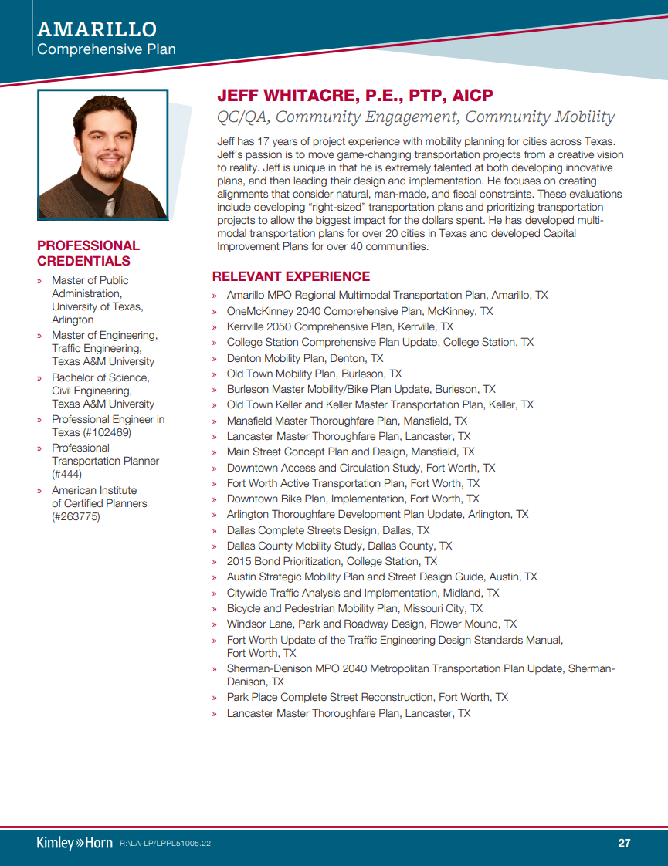
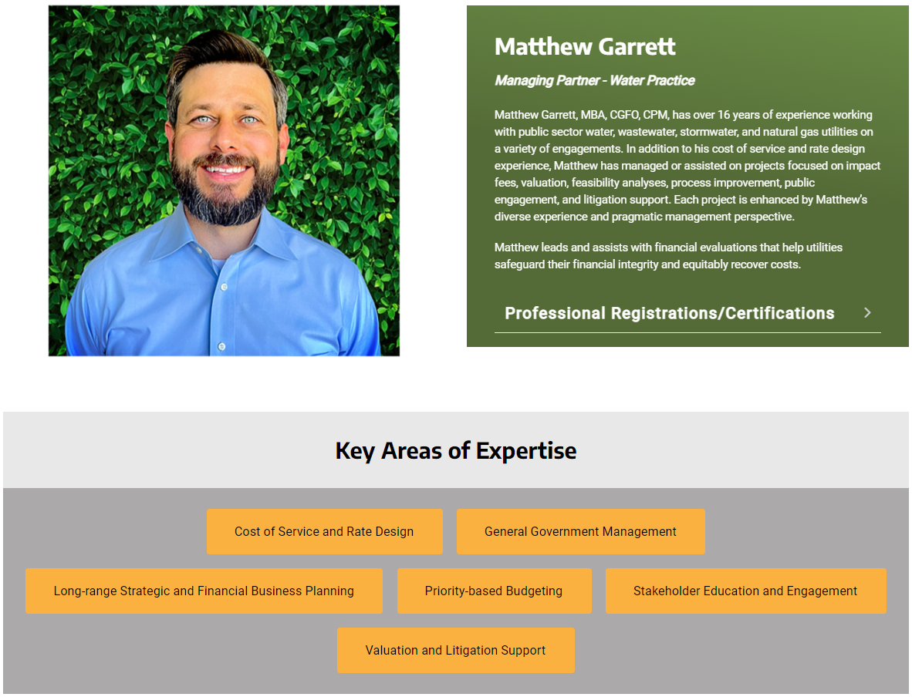
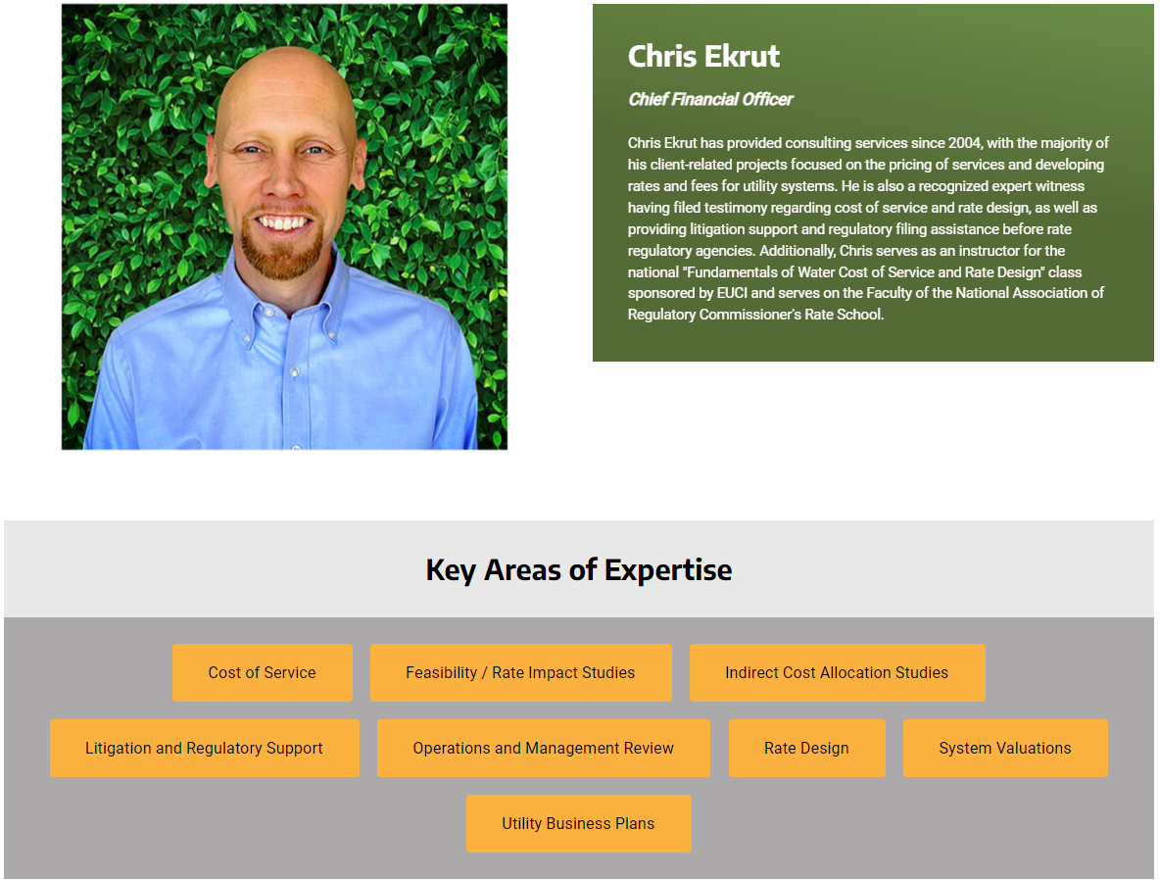

Slide 17
Next Steps
Anticipated Schedule
  Wednesday February 23 – Funding Basics and Options
  Thursday March 9 – Enterprise Fund Basics & Specific to Amarillo
  Thursday March 16 – Levels of Service
  Thursday March 23 – What gets Funded - Direct and Indirect Costs
  Wednesday April 5 – Costs Recap and Fee Basics
  Thursday April 20 – Options & Discounts
  Wednesday April 26 – Implementation Methods
  Anticipated Schedule
Homework Assignments
Office Hours

Slide 18
Commitment from You
Participate in as many meetings as possible.
Complete the Homework assignments.
Ask questions.
Think like a Representative of your sphere of influence.
Candor and Good Will.

