Slide 1
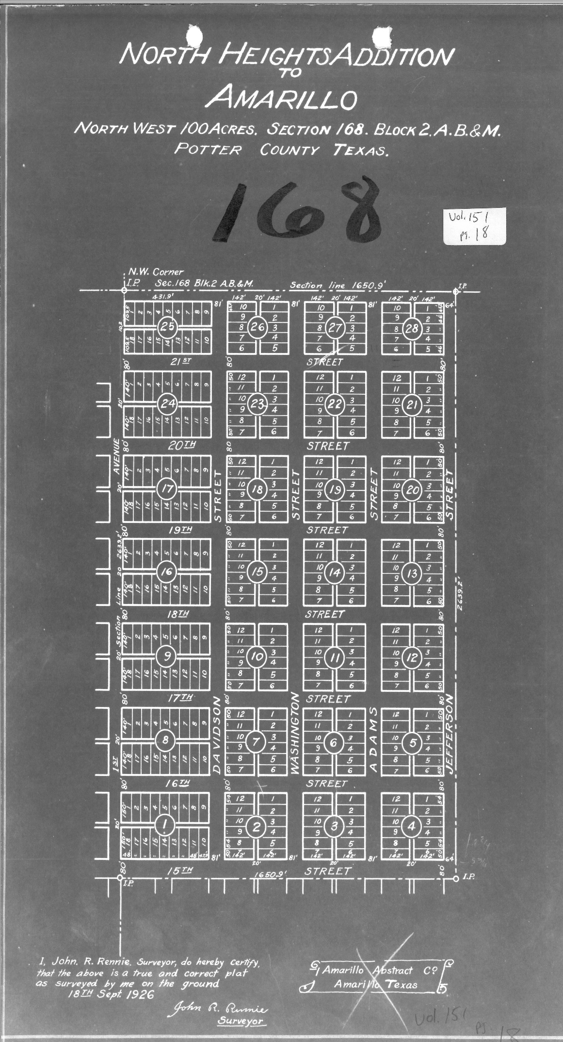
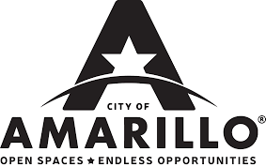
North Heights
Rezoning Initiative – Part 2
(South, Quadrant 1)
Planning and Zoning Commission
Presentation
August 16th, 2021

Slide 2
Approval Schedule – Status Update
Part 1 (North)
Tabled August 10th and scheduled for consideration by City Council on Tuesday, August 24th
Part 2 (South)
Action item presented to Planning and Zoning Commission today (August 16th)
First reading and public hearing scheduled for City Council on Tuesday, September 14th

Slide 3
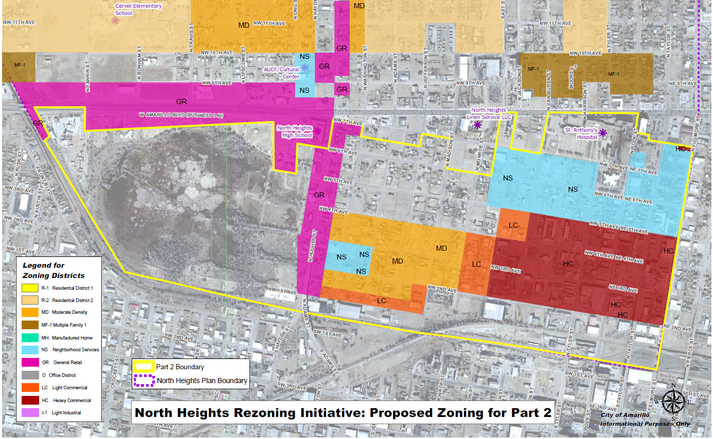
168.88 Acres
Quadrant 1
Notes:
Part 1 Rezoning Proposal includes 168.99 Acres as just described

Slide 4
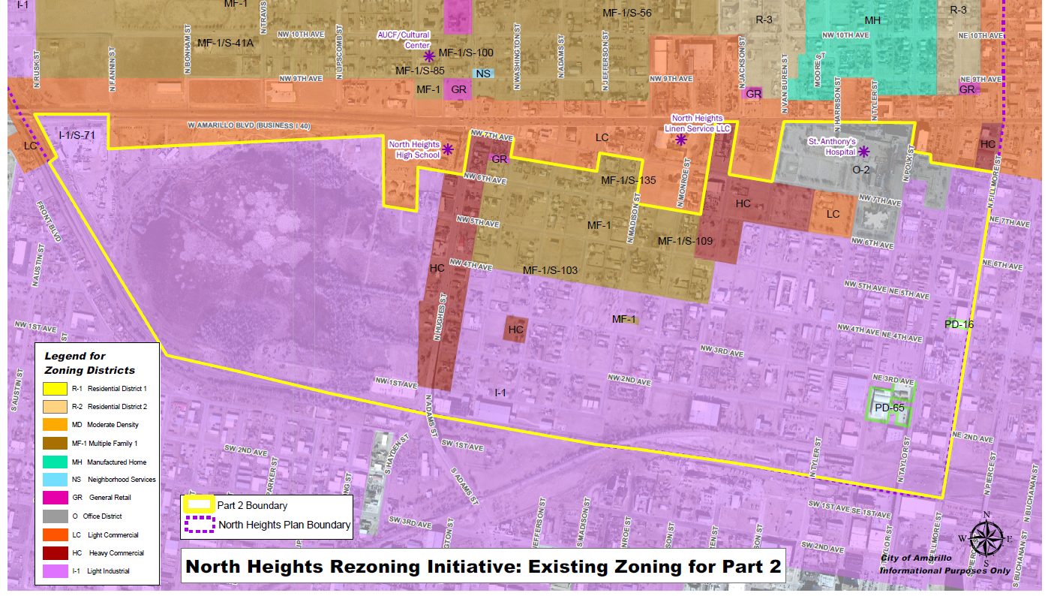
Part 2 Existing Zoning
Notes:
Existing zoning is a primarily industrial with some Heavy Commercial, Multi-family and Office. The properties along Amarillo Boulevard are generally not included in Part 2 boundary.

Slide 5
Citizen Primary Concerns
“Down-zoning” resulting in less marketable property
Property value depreciation
A small number of citizens speaking on behalf of the larger community
Lack of consensus among stakeholders for the proposal
The City’s ability to rezone without consent
Existing allowed land uses becoming legal nonconforming status
Additional comments received prior to August 16th meeting
Five signed business “in favor” statements gathered by NHAA
Notes:
Since the required property owner notices for this meeting were mailed on August 4th, staff has not received any additional calls or letters resulting from those notices except for several seeking more information.
Multiple written responses in opposition were received earlier in the process regarding Part 2 and were forwarded to the Commissioners.
The primary concerns expressed for Part 2 are “down-zoning” resulting in less marketable property; that existing allowed uses will become legal non-conforming; why the area south of Amarillo Blvd. is part of the North Heights plan area; and, that the project seems to have a small number of citizens speaking on behalf of the larger community.

Slide 6
Analysis – Part 2
While the general perception is that this is a commercial and industrial area, an equal percentage of the area proposed to be rezoned is currently used for residential purposes.
It is staff’s opinion that this particular part of the plan area is at a critical tipping point which will determine the predominant character and development pattern of the area moving forward.
Should the proposed zoning pattern be significantly altered, deviated from or not approved altogether, staff believes that further erosion of what was once a thriving business and community center for the North Heights neighborhood will continue.
The intent of the rezoning is not to “downzone” existing commercial properties, but to develop a more orderly land use pattern so they may continue to operate in their current location without interference while preventing potentially more intensive industrial uses in the future that would have a detrimental impact on rebuilding the neighborhood.
Part 2: Current Land Use by PRAD Parcel*
Non-Residential | 136 | 39%
Residential | 129 | 37%
Vacant | 83 | 24%
Total | 348 | 100%
*Inventory of parcels proposed to change
Notes:
Considering existing zoning and developing patterns, Part 2 of the North Heights Rezoning Initiative presents a greater challenge in achieving the eleven recommendations for the North Heights plan area. While the general perception is that this is a commercial and industrial area, an equal percentage of the area proposed to be rezoned is currently used for residential purposes.
Referencing the inventoried parcels, it is staff’s opinion that this particular part of the plan area is at a critical tipping point which will determine the predominant character and development pattern of the area moving forward. Should the proposed zoning pattern be significantly altered, deviated from or not approved altogether, staff believes that further erosion of what was once a thriving business and community center for the North Heights neighborhood will continue. Encroachment of industrial uses over time has made what was historically known as the Flats (between SW 1st and SW 3rd and west of Polk St) unrecognizable and those same development patterns will continue to alter the character of the North Heights plan area especially the portion west of N Monroe St if no changes are made to current zoning patterns.
The intent of the rezoning is not to “downzone” existing commercial properties, but to develop a more orderly land use pattern so they may continue to operate in their current location without interference while preventing potentially more intensive industrial uses in the future that would have a detrimental impact on rebuilding the neighborhood.
When considered in its entirety (both Part 1 and Part 2), the northern part of the neighborhood is planned to be primarily single-family residential, while the southern part of the plan area would encourage a mix of apartments, duplexes, triplexes in proximity to a general retail corridor on Hughes St and the St. Anthony’s hospital redevelopment. The existing commercial and industrial uses along the railroad tracks to the south and in the southeast portion of the plan area would be unaffected. There is no business currently operating in those areas that would become a legal nonconforming use as a result of the rezoning proposal.
Amarillo’s Comprehensive Plan utilizes the Neighborhood Unit Concept where commercial development lines the major corridors and single family is protected at the core. While the existing land uses in Part 2 make it difficult to achieve, this proposal does better align this portion of the North Heights plan area with the comprehensive plan, therefore meeting the City’s overall objectives of protecting public health, safety and welfare through land use planning.

Slide 7
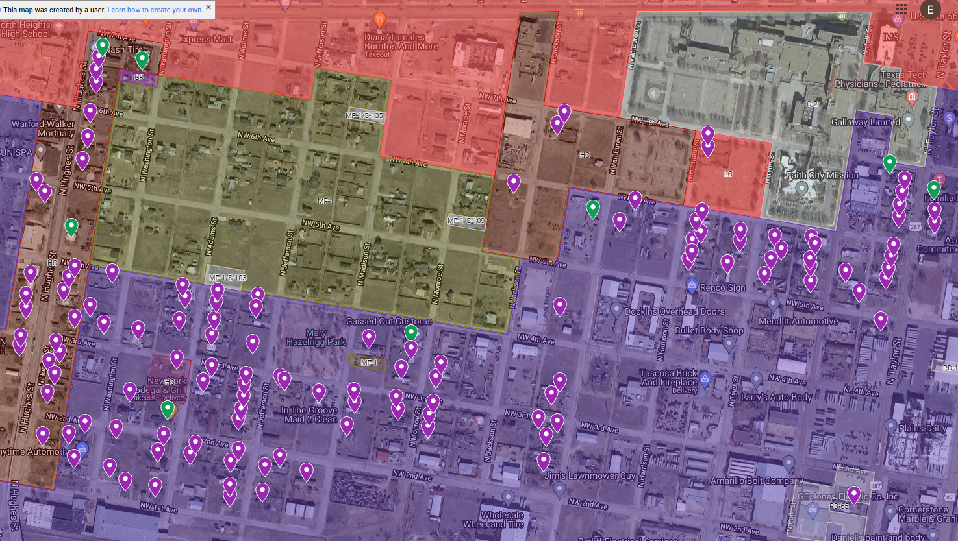
Notes:
There are 97 residentially used properties currently in Light Industrial Zoning; 23 in Heavy Commercial
148 Residential Properties that are currently non-conforming

Slide 8
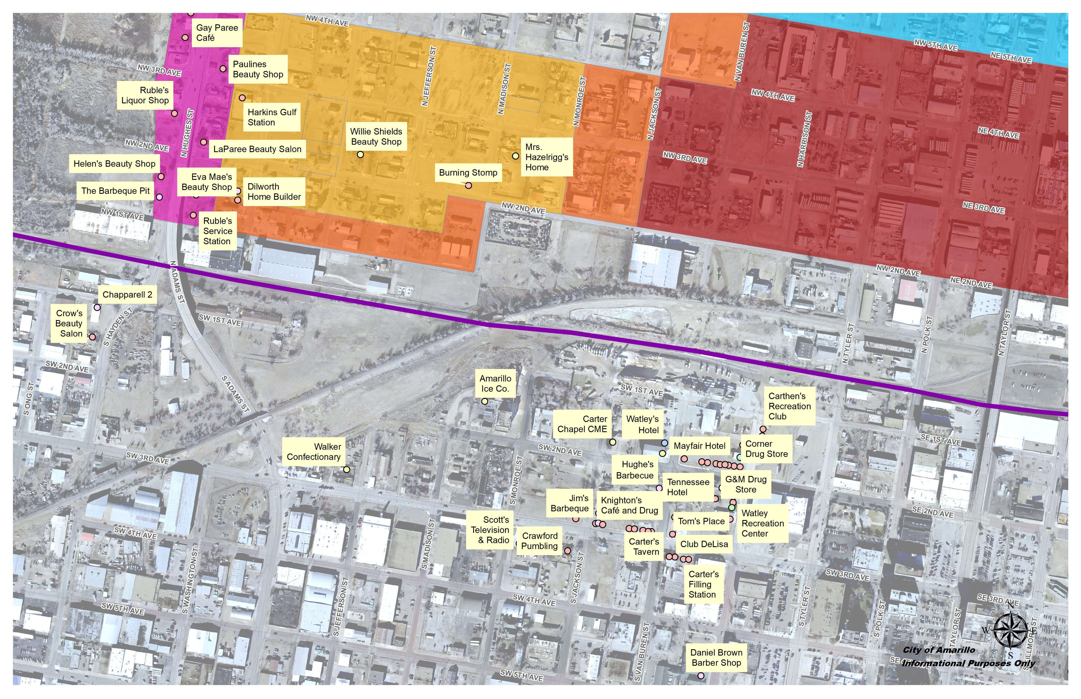
North Heights -
Historic Businesses
Notes:
These slides were used at the workshops – the historic businesses have been identified through a previous inventory by the neighborhood and mapped here.
Obviously, this area is no longer seen as a business hub for the neighborhood. The rezoning proposal seeks to reverse the trend of encroachment of intensive industrial uses and allow the possibility of rebuilding the neighborhood with these types of businesses in the future.

Slide 9
Legal nonconforming uses
If your current use is not included in allowed uses (also known as a legal nonconforming use), the current use will be allowed to continue even if:
A. You sell the property to a new owner;
B. Your tenants change, but the same use continues (ie BBQ restaurant to Mexican restaurant);
C. Your house or business is destroyed by fire or natural disaster – it can be reconstructed to the previous condition within two years if approved by the Zoning Board of Adjustment;
D. You deed the property to an heir through your estate.

Slide 10
Legal nonconforming uses (continued)
However, a property will be required to comply with zoning regulations in the future if you choose to:
A. Expand the use beyond its current tract;
B. Let the property sit vacant with no active use for 12 months (note the new code proposes 6 months);
C. Bring in a tenant with a business that is allowed in the new zoning district. You will not be able to return to the previous legal nonconforming use.

Slide 11
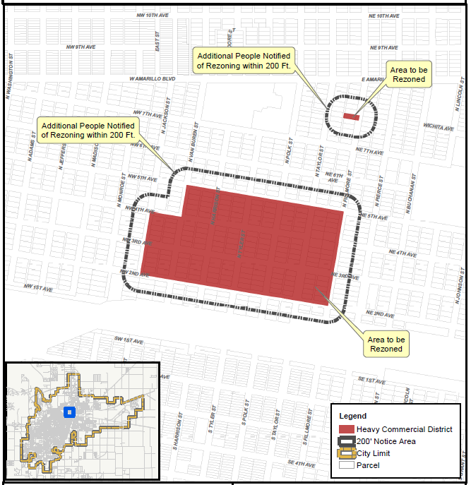
Heavy Commercial (HC)
56.38 acres
From primarily from Light Industrial District (I-1) and Planned Development Districts 16 and 65
Intent – Accommodate existing commercial activity and prevent most intensive industrial uses in the future
Existing Non-Conforming Uses – 8 (all residential)
Proposed Non-Conforming Summary
  8 One-Family
Notes:
Adds positive uses that are more compatible to the neighborhood such as Adult Businesses, Topless Bars, Shooting Ranges, Intensive Manufacturing, special Industrial processes.

Slide 12
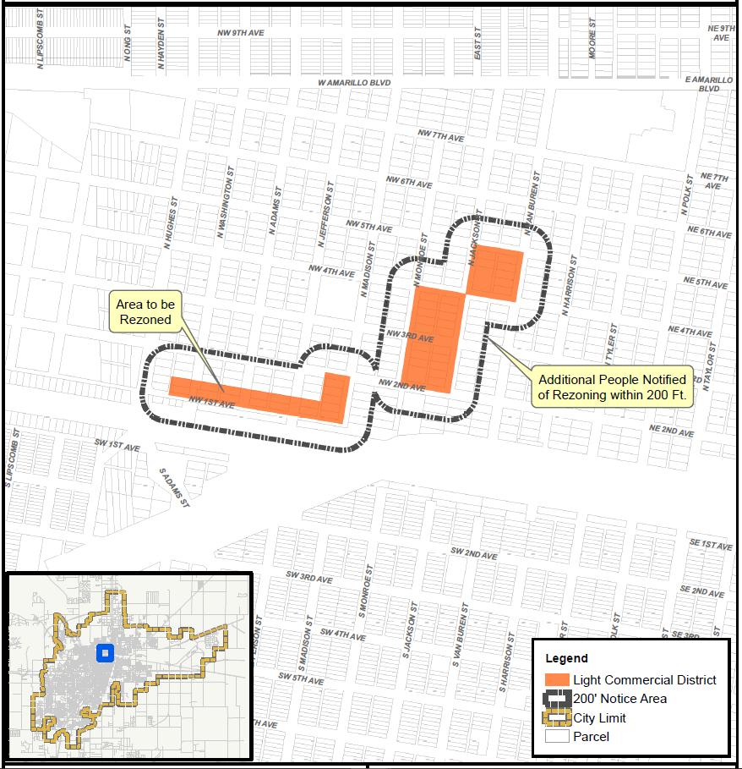
Light Commercial (LC)
15.11 acres
From Light Industrial (I-1)
Intent – Buffer most commercial and industrial uses from residential
Existing Non-Conforming Uses – 14 (all residential)
Proposed Non-Conforming Summary
  1 Two-Family
  1 Manuf. Home
  12 One-Family

Slide 13
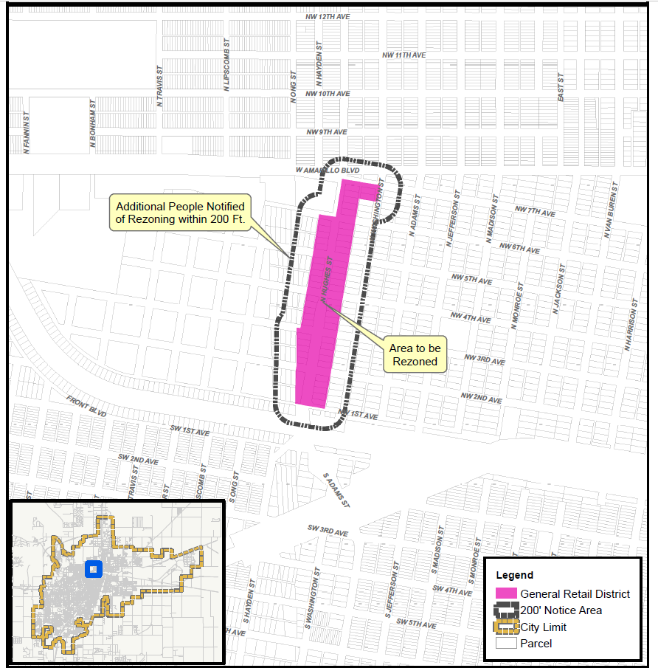
General Retail (GR)
17.58 acres
From Heavy Commercial (HC)
Intent – Transition to a retail corridor
Existing Non-Conforming Uses – 25 (23 residential, 2 salvage)
Proposed Non-Conforming Summary
  3 Manuf. Home
  20 One-Family
  2 Salvage
  2 Auto Related*
  *Permitted with SUP

Slide 14
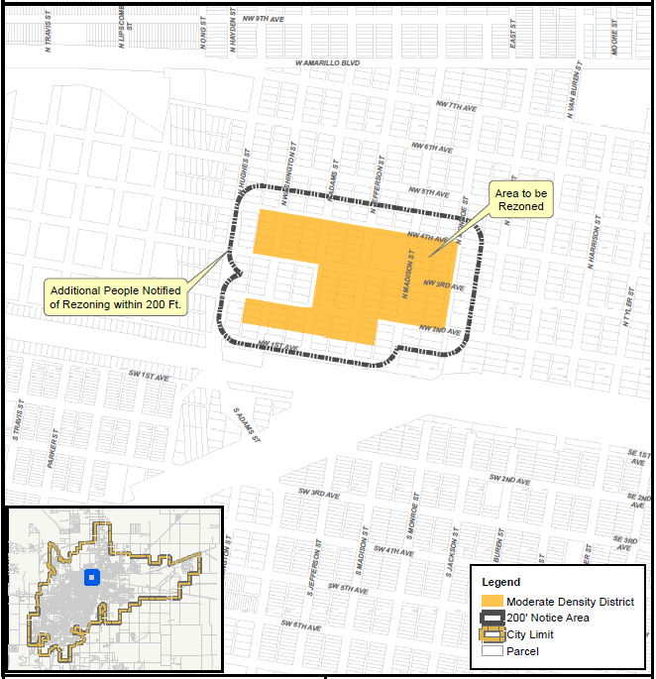
Moderate Density (MD)
30.63
From primarily Multiple-Family 1 (MF-1) and Light Industrial (I-1)
Intent – Matches existing residential character; envisioned in the original comprehensive proposal as the appropriate location for a mix of housing types
Existing Non-Conforming Uses – 43 (all residential)
Proposed Non-Conforming Summary - 10
  7 Manuf. Home
  1 Storage Facility
  2 Utility Shops/Private Storage

Slide 15
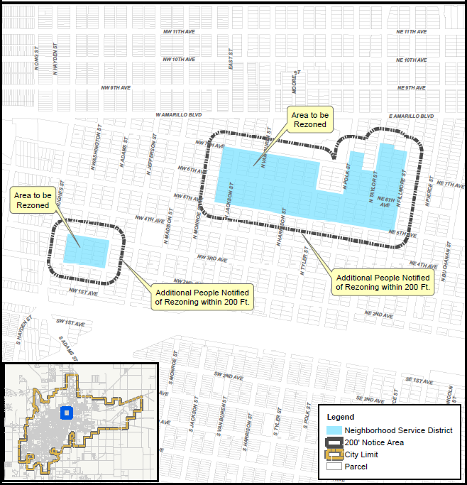
Neighborhood Services (NS)
49.18 acres
From primarily Heavy Commercial (HC), Light Commercial (LC) and Light Industrial (I-1)
Intent – Neighborhood services allows both residential (SF, MD types) and low-impact businesses. Provide a mixed use, more walkable urban neighborhood around the St. Anthony’s hospital redevelopment ($30MM senior housing project coming first)
Existing Non-Conforming Uses – 44
Proposed Non-Conforming Uses - 15
  4 Manuf. Home
  1 Hauling/Storage
  1 Auto related
  1 Contractor Storage.
  1 Drinking Place
  3 Trade Contractor
  1 Utility Shop
  1 Storage Warehouse
  1 New Bldg Material Sales
  1 Eating Place – Permitted with SUP

Slide 16
Staff Recommendation
Staff finds that the proposal for Part 2 of the North Heights Rezoning Initiative is:
Consistent with the vision and strategies in the North Heights Neighborhood Plan;
Consistent with the adopted Future Land Use maps for the area; and,
Better aligns the zoning pattern in North Heights with the Neighborhood Unit Concept in the Amarillo Comprehensive Plan.
Staff recommends approval of the rezoning proposal for Part 2 of the North Heights Rezoning Initiative as presented.

Slide 17
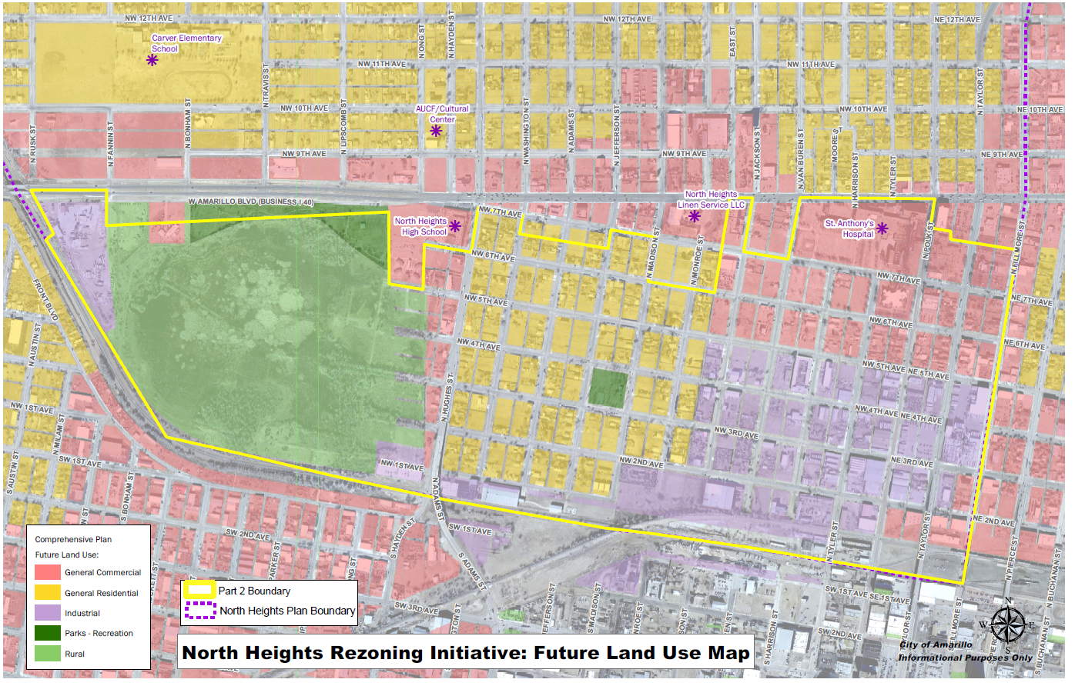
Part 2 Future Land Use

