Slide 1
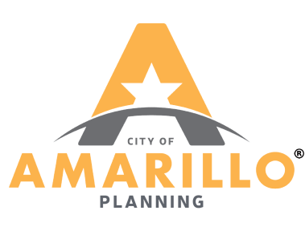

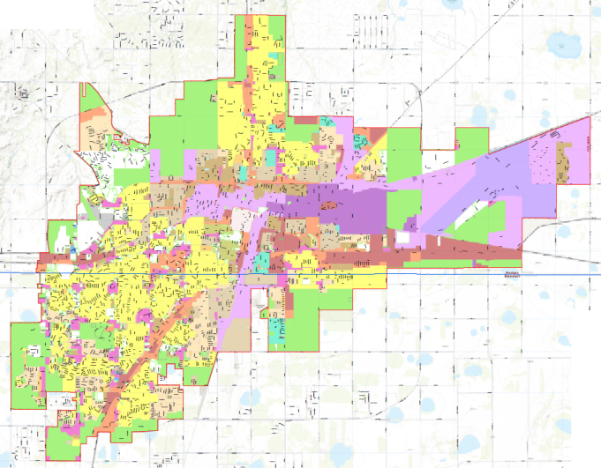
Community Counts
North Heights Neighborhood Plan Workshop
April 14, 2016

Slide 2
Neighborhood Plan: Process
Data Collection/Analysis
Formulation of Goals
Create Action Plan
Adopt Plan
Implement Plan
Identify Challenges/Opportunities
Identify Objectives
Identify /Assess strategies
Performance Evaluation
Public Participation

Slide 3
Tonight’s meeting
Place your 3 stickers on your top priorities for the North Heights
Sticker color does not mean anything
Your input will help us determine the Goals and Objectives for the North Heights Neighborhood Plan

Slide 4
Key Themes
Housing
Neighborhood Appearance
Open Space & Recreation
Social & Safety Elements
Economic & Revitalization
Mobility

Slide 5
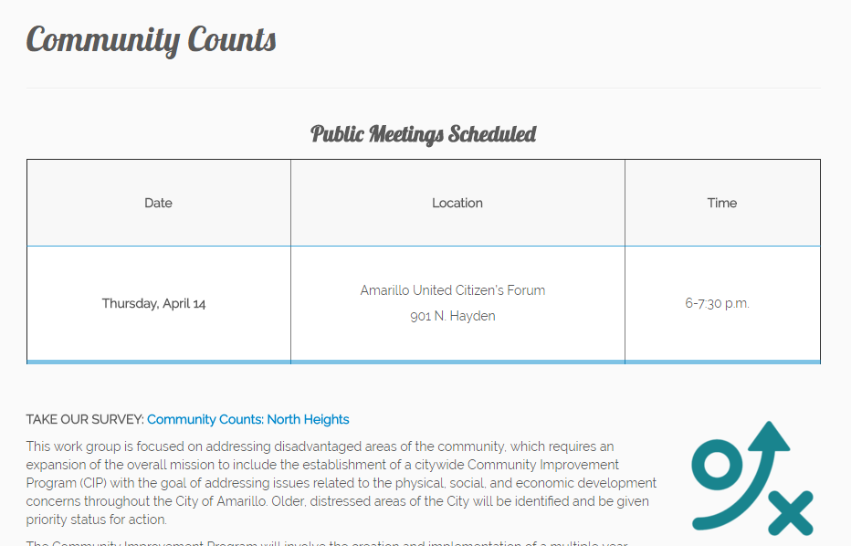
Community Counts
For more information and updates check out the Community Counts webpage at http://blueprint.amarillo.gov/
Take the North Heights Survey

