Slide 1
Amarillo Continuum of Care
Who are we and what do we do?

Slide 2

C.O.C.
Broadly defined, a C.O.C. is a collaboration of all homeless service providers in a geographic area.

Slide 3

C.O.C.
According to Housing and Urban Development (HUD), a C.O.C. is “a community plan to organize and deliver housing and services to meet the specific needs of people who are homeless as they move to stable housing and maximize self-sufficiency.”

Slide 4

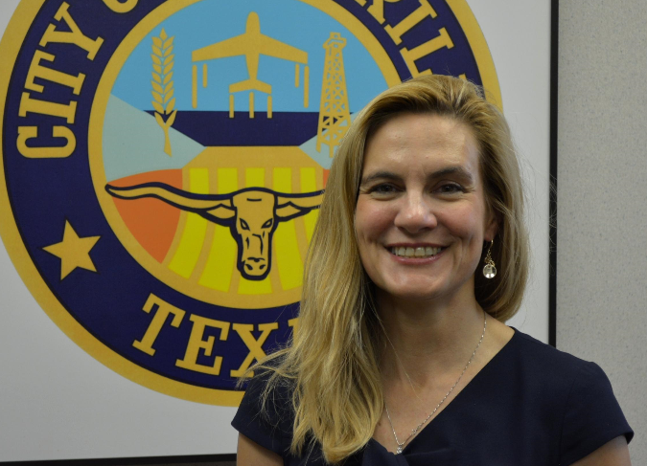
Lead Agency
City of Amarillo Community Development
Director Juliana Kitten
Responsible for coordinating the COC and submitting the yearly application to HUD.

Slide 5

H.M.I.S.
HMIS is a locally administered, electronic data collection system that stores longitudinal person-level information about persons who access the homeless service system in a Continuum of Care.
Amy Dixon, HMIS Coordinator

Slide 6

Point in Time (PIT) Count
Annual (or bi-annual) census to collect data on the needs of people experiencing homelessness in our community.

Slide 7


























Who are we?

Slide 8

Amarillo Continuum of Care (C.O.C.)

Slide 9

What was that?
ARAD- Amarillo Recovery from Alcohol and Drugs
ARC-Alcoholic Recovery Center
ACH- Another Chance House
AHF-Amarillo Housing First
CCTXP- Catholic Charities of the Texas Panhandle
CDBG-Community Development Block Grant
CIT-Crisis Intervention Team
COC-Continuum of Care
DWC-Downtown Women’s Center
FSS-Family Support Services
GSRC-Guyon Saunders Resource Center
HMIS-Homeless Management Information System
MCOT-Mobile Crisis Outreach Team
PATH- Projects for Assistance in Transition from Homeless
PIT-Point in Time Count
RHY- Runaway and Homeless Youth
SSVF- Support Services for Veteran Families
TPC-Texas Panhandle Centers
VA- Veterans Administration
VASH- Veterans Administration Supportive Housing
VAT-Vulnerability Assessment Tool
VRC-Veterans Resource Center
YCCO- Yellow City Community Outreach
YHDP- Youth Homelessness Demonstration Program

